Slide 1
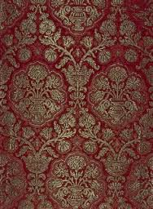

2-D Cluster Variation Method: Comparison of Computational and
Analytic Results
with
Alianna J. Maren, Ph.D.
Verification and Validation
Revised: December 29, 2018

Slide 2

Alianna J. Maren, Ph.D.
Developed foundational AI courses for Northwestern University’s SPS program – Master of Science in Data Science:
MSDS 458: AI & Deep Learning,
MSDS 453: Natural Language Processing
Four patents:
Biologically-based sensor fusion
Knowledge discovery
Predictive analytics
Evidence-based reasoning
Recent publications:
Brain Sciences
arXiv
Links to all at:
www.aliannajmaren.com

Slide 3
Where We Left Off (in the Previous Slidedeck)
GitHub: ajmaren/2D-Cluster-Variation-Method
2D-CVM_Expts-vary-eps0-and-eps1_2018-12-29.pptx
Illustration of Two Different Grid Patterns
in the 2-D CVM – Recapitulate Previous Results
Note: Approximate; Counts only Horizontal Triplets
Illustrates two different grid patterns, both for the case where epsilon0 = 0; meaning x₁ = x₂ = 0.5, or equiprobable distribution among the two states; the two patterns have different h-values:
Scale-free-like pattern, and
Rich club-like pattern
Counts z₁ and z₃ (triplet) configuration variables in each
Validates that the computer code produces the same results as manual
Counts the horizontal triplets only – approximation of total

Slide 4
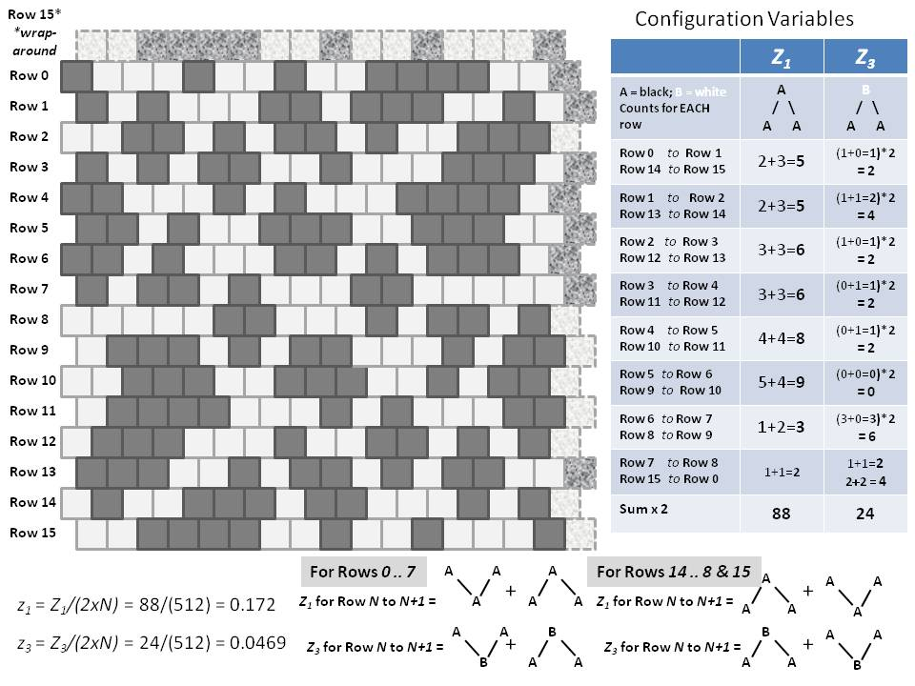
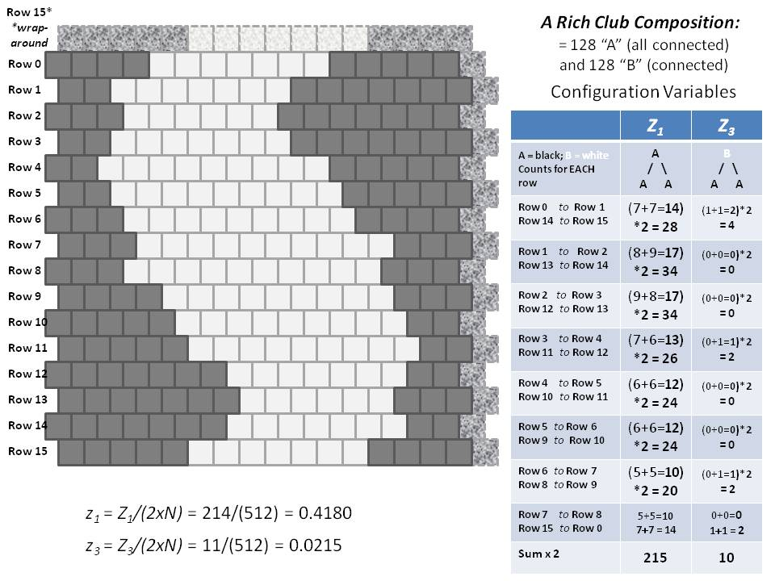
Two Different Configurations for a 2-D CVM Grid
Equiprobable unit distribution (x₁ = x₂ = 0.5)
Each grid contains 256 units (16 x 16)
(a)
Scale-free-like topography
(b)
Extreme rich club-like topography

Slide 5


Row 15*
*wrap-around
A Rich Club-Like Composition:
= 128 “A” (all connected)
and 128 “B” (connected)
Row 0
Configuration Variables
Row 1
Horizontal Triplets | Z₁ | Z₃
A = black; B = white Counts for EACH row | A / \ A A | B / \ A A
Row 0 to Row 1 Row 14 to Row 15 | (7+7=14) *2 = 28 | (1+1=2)*2 = 4
Row 1 to Row 2 Row 13 to Row 14 | (8+9=17) *2 = 34 | (0+0=0)*2 = 0
Row 2 to Row 3 Row 12 to Row 13 | (9+8=17) *2 = 34 | (0+0=0)*2 = 0
Row 3 to Row 4 Row 11 to Row 12 | (7+6=13) *2 = 26 | (0+1=1)*2 = 2
Row 4 to Row 5 Row 10 to Row 11 | (6+6=12) *2 = 24 | (0+0=0)*2 = 0
Row 5 to Row 6 Row 9 to Row 10 | (6+6=12) *2 = 24 | (0+0=0)*2 = 0
Row 6 to Row 7 Row 8 to Row 9 | (5+5=10) *2 = 20 | (0+1=1)*2 = 2
Row 7 to Row 8 Row 15 to Row 0 | 5+5=10 7+7 = 14 | 0+0=0 1+1 = 2
Sum x 2 | 214 | 10
Row 2
Row 3
Row 4
Row 5
Row 6
Row 7
Row 8
Row 9
Row 10
Row 11
Row 12
Row 13
Row 14
Row 15
Illustration based on counting the horizontal triplets only:
z₁ = Z₁/(2xN) = 214/(512) = 0.4180
z₃ = Z₃/(2xN) = 10/(512) = 0.0195

Slide 6
Row 15*
*wrap-around
A Scale-Free-Like Composition
Configuration Variables
Horizontal Triplets | Z₁ | Z₃
A = black; B = white Counts for EACH row | A / \ A A | B / \ A A
Row 0 to Row 1 Row 14 to Row 15 | (2+3=5)*2 = 10 | (1+0=1)*2 = 2
Row 1 to Row 2 Row 13 to Row 14 | (2+3=5)*2 = 10 | (1+1=2)*2 = 4
Row 2 to Row 3 Row 12 to Row 13 | (3+3=6)*2 = 12 | (1+0=1)*2 = 2
Row 3 to Row 4 Row 11 to Row 12 | (3+3=6)*2 = 12 | (0+1=1)*2 = 2
Row 4 to Row 5 Row 10 to Row 11 | (4+4=8)*2 = 16 | (0+1=1)*2 = 2
Row 5 to Row 6 Row 9 to Row 10 | (5+4=9)*2 = 18 | (0+0=0)*2 = 0
Row 6 to Row 7 Row 8 to Row 9 | (1+2=3)*2 = 6 | (3+0=3)*2 = 6
Row 7 to Row 8 Row 15 to Row 0 | (1+1=2)*2 = 4 | 1+1=2 2+2 = 4
Sum | 88 | 24
Row 0
Row 1
Row 2
Row 3
Row 4
Row 5
Row 6
Row 7
Row 8
Row 9
Row 10
Row 11
Row 12
Row 13
Row 14
Row 15
For Rows 0 .. 7
A
A
A
For Rows 14 .. 8 & 15
A
A
A
+
+
z₁ = Z₁/(2xN) = 88/(512) = 0.172
Z₁ for Row N to N+1 =
A
A
A
Z₁ for Row N to N+1 =
A
A
A
z₃ = Z₃/(2xN) = 22/(512) = 0.0430
A
A
B
B
A
A
Z₃ for Row N to N+1 =
+
Z₃ for Row N to N+1 =
+
B
A
A
A
A
B

Slide 7
Details of Counting Horizontal Triplets for the Two Different Grid Configurations
Rich Club-Like Topography
Scale-Free-Like Topography
Horizontal Triplets | Z₁ | Z₃
A = black; B = white Counts for EACH row | A / \ A A | B / \ A A
Row 0 to Row 1 Row 14 to Row 15 | (7+7=14) *2 = 28 | (1+1=2)*2 = 4
Row 1 to Row 2 Row 13 to Row 14 | (8+9=17) *2 = 34 | (0+0=0)*2 = 0
Row 2 to Row 3 Row 12 to Row 13 | (9+8=17) *2 = 34 | (0+0=0)*2 = 0
Row 3 to Row 4 Row 11 to Row 12 | (7+6=13) *2 = 26 | (0+1=1)*2 = 2
Row 4 to Row 5 Row 10 to Row 11 | (6+6=12) *2 = 24 | (0+0=0)*2 = 0
Row 5 to Row 6 Row 9 to Row 10 | (6+6=12) *2 = 24 | (0+0=0)*2 = 0
Row 6 to Row 7 Row 8 to Row 9 | (5+5=10) *2 = 20 | (0+1=1)*2 = 2
Row 7 to Row 8 Row 15 to Row 0 | 5+5=10 7+7 = 14 | 0+0=0 1+1 = 2
Sum x 2 | 214 | 10
Horizontal Triplets | Z₁ | Z₃
A = black; B = white Counts for EACH row | A / \ A A | B / \ A A
Row 0 to Row 1 Row 14 to Row 15 | 2+3=5 *2 = 10 | (1+0=1)*2 = 2
Row 1 to Row 2 Row 13 to Row 14 | 2+3=5 *2 = 10 | (1+1=2)*2 = 4
Row 2 to Row 3 Row 12 to Row 13 | 3+3=6 *2 = 12 | (1+0=1)*2 = 2
Row 3 to Row 4 Row 11 to Row 12 | 3+3=6 *2 = 12 | (0+1=1)*2 = 2
Row 4 to Row 5 Row 10 to Row 11 | 4+4=8 *2 = 16 | (0+1=1)*2 = 2
Row 5 to Row 6 Row 9 to Row 10 | 5+4=9 *2 = 18 | (0+0=0)*2 = 0
Row 6 to Row 7 Row 8 to Row 9 | 1+2=3 *2 = 6 | (3+0=3)*2 = 6
Row 7 to Row 8 Row 15 to Row 0 | 1+1=2 *2 = 4 | 1+1=2 2+2 = 4
Sum x 2 | 88 | 24

Slide 8
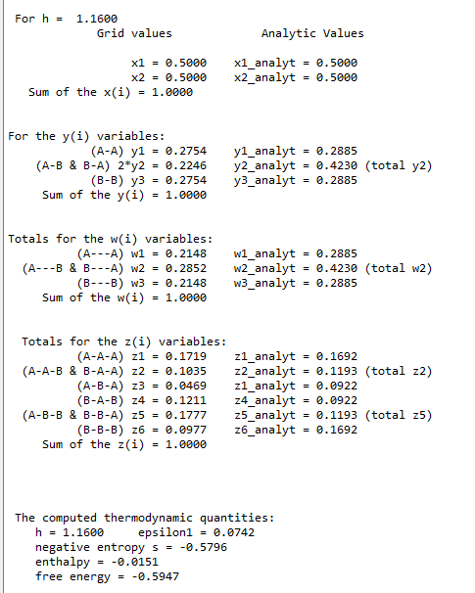
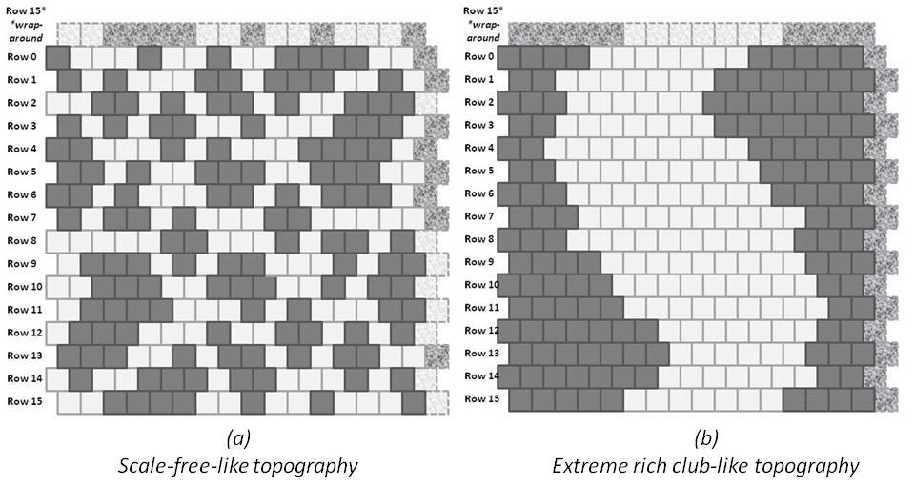
A Scale-Free-Like Composition: Code Validation
z₁ = Z₁/(2xN) = 88/(512) = 0.172
z₃ = Z₃/(2xN) = 24/(512) = 0.0469
Hand-counted z₁ and z₃ values:
Code validation step
Approximate h-value: 1.16
NOTE: Hand-crafted pattern has unequal values for z₁ & z₆, etc., so the h-value can only be approximate; the pattern is not an equilibrium one.
Program: 2D-CVM_defined-patterns_analytic-solution_2017-12-08_rev_2018-11-22.py
Run Date: 11/23/2018 Private GitHub: 2-D-CVM-Random-Pattern-Configurations

Slide 9
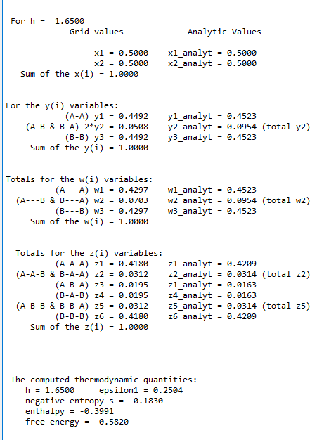
An Extreme Rich Club-Like Composition: Code Validation
z₁ = Z₁/(2xN) = 214/(512) = 0.4180
z₃ = Z₃/(2xN) = 10/(512) = 0.0195
Hand-counted z₁ and z₃ values:
Code validation step
Approximate h-value: 1.65
NOTE: Hand-crafted pattern has equal values for z₁ & z₆, etc., so the h-value corresponds to the hand-counts. However: the analytic solution diverges as h gets larger.
Program: 2D-CVM_defined-patterns_analytic-solution_2017-12-08_rev_2018-11-22.py
Run Date: 11/23/2018 Private GitHub: 2-D-CVM-Random-Pattern-Configurations

Slide 10
Two Extremely Different Topographies Give the Range of Useful h-values
(a)
Scale-free-like topography
(b)
Extreme rich club-like topography
Approximate h-value: 1.16
Approximate h-value: 1.65

Slide 11
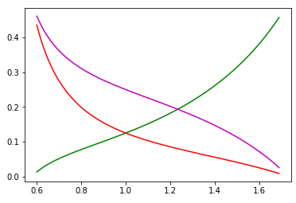
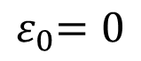
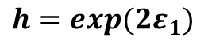
We Can Obtain Analytic Results for Certain Cases
Analytic Values for Configuration Variables y₂, z₁, and z₃
Case where activation enthalpy : x₁ = x₂ = 0.5
$${ ε}_{0}=0$$
B
A
A
y₂
Z₃:
Z₁:
y₂:
B
B
A
A
A
A
A
z₁
Configuration variable
z₃
y₂
z₁
h = 1 (ε₁ = 0)
For h = 1:
z₃
y₂ = 0.250
z₁ = 0.125
z₃ = 0.125
h: interaction enthalpy parameter;
$${ h=exp(2ε}_{1})$$

Slide 12
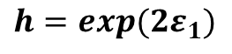
Analytic Values for Configuration Variables y₂, z₁, and z₃
Scale-Free-Like
Extreme Rich Club-Like and Scale-Free-Like Patterns
B
A
A
For h = 1.16:
Z₃:
Z₁:
y₂:
B
B
A
A
A
A
y₂ = 0.212
A
z₁ = 0.169
Configuration variable
y₂
Scale-Free-Like
z₃ = 0.092
h = 1.16
(ε₁ = 0.074)
z₃
Rich Club-Like
Rich Club-Like
h = 1.65
(ε₁ = 0.250)
z₁
For h = 1.65:
y₂ = 0.047
z₁ = 0.418
Approximate Useful Range for h
z₃ = 0.020
h: interaction enthalpy parameter;
$${ h=exp(2ε}_{1})$$

Slide 13
We Previously Presented the Analytic Solution:
The Left-Hand-Side Axis: Variations in Epsilon1
Illustration of Grid Patterns in the 2-D CVM
Note: Approximate; Counts only Horizontal Triplets

Slide 14
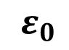
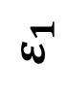
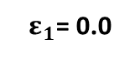
Illustrating a Point on the eps0 = 0, eps1 Variation Axis
For the case where epsilon0 = 0 (no activation enthalpy), we are working down the left-hand-side vertical axis of this graph.
We solve for each value of x1 computationally, as a result of setting the derivative of the free energy equal to zero for a given value of the activation enthalpy eps0.
$${ ε}_{0}$$
(Activation Enthalpy Parameter)
0.0
1.0
2.0
3.0
4.0
x₁
0.500
0.269
0.119
0.047
0.018
0.0
1
0.1
0.500
1
For eps0 = 0 and h = 1.0:
${ ε}_{1}$= 0.0
x₁ = 0.500; FE = -0.697
0.2
0.500
(Interaction Enthalpy Parameter)
We want to fill in values along this vertical axis
0.3
0.500
0.4
0.500
$${ ε}_{1}$$
0.5
0.500

Slide 15
Recall Previous Analytic Results:
Analytic Values for Configuration Variables y₂, z₁, and z₃
Scale-Free-Like
Extreme Rich Club-Like and Scale-Free-Like Patterns
B
A
A
For h = 1.16:
Z₃:
Z₁:
y₂:
B
B
A
A
A
A
y₂ = 0.212
A
z₁ = 0.169
Configuration variable
y₂
Scale-Free-Like
z₃ = 0.092
h = 1.16
(ε₁ = 0.074)
z₃
Rich Club-Like
Rich Club-Like
h = 1.65
(ε₁ = 0.250)
z₁
For h = 1.65:
y₂ = 0.047
z₁ = 0.418
Approximate Useful Range for h
z₃ = 0.020
h: interaction enthalpy parameter;
$${ h=exp(2ε}_{1})$$

Slide 16
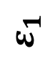
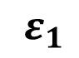
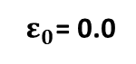
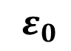
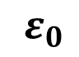
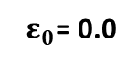
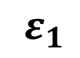
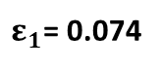
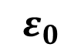
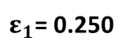
Our Goal is to Fill in the Phase Space Values
$${ ε}_{0}$$
$${ ε}_{1}$$
Configuration Variables are Functions of and
Values Found at Equilibrium
$${ ε}_{0}$$
$${ ε}_{1}$$
x₁ vs (Activation Enthalpy Parameter) and (Interaction Enthalpy Parameter)
$${ ε}_{0}$$
(Activation Enthalpy Parameter)
x₁
0.0
1.0
2.0
3.0
4.0
5.0
0.0
0.500
0.269
0.119
0.047
0.018
0.007
Scale-Free-Like
We obtained two complete data points (values for x₁, y₂, z₁, and z₃) by manually-generating different patterns (with eps0 = 0, so x₁ = 0.5), counting the configuration variables, and finding the corresponding h-values that yielded those configuration values. Then we located these on the left-hand vertical axis.
0.1
0.500
Rich Club-Like
0.2
0.500
(Interaction Enthalpy Parameter)
${ ε}_{0}$= 0.0
0.3
0.500
For h = 1.16:
${ ε}_{1}$= 0.074
${ ε}_{0}$= 0.0
For h = 1.65:
x₁ = 0.500
${ ε}_{1}$= 0.250
0.4
0.500
$${ ε}_{1}$$
y₂ = 0.212
x₁ = 0.500
0.5
0.500
z₁ = 0.169
y₂ = 0.047
z₃ = 0.092
z₁ = 0.418
z₃ = 0.020

Slide 17
Defining the Phase Space Boundaries
Program Used:
2D-CVM-simple-eq_no-interaction-calc_v2_2018-10-27.py

Slide 18
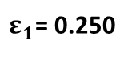
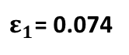
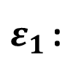
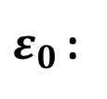


Our Goal is to Fill in the Phase Space Values
Pragmatically, we only need a portion of the grid
$${ ε}_{0}$$
$${ ε}_{1}$$
x₁ vs (Activation Enthalpy Parameter) and (Interaction Enthalpy Parameter)
$${ ε}_{0}$$
(Activation Enthalpy Parameter)
x₁
0.0
1.0
2.0
3.0
4.0
5.0
0.0
0.500
0.269
0.119
0.047
0.018
0.007
Scale-Free-Like
Useful portion
Useful portion of the grid is bounded by:
0.1
0.500
0.2
0.500
Rich Club-Like
(Interaction Enthalpy Parameter)
${ ε}_{0 }$< 3.0
For h = 1.16:
$ε_{1}$< 0.25
0.3
0.500
${ ε}_{1}$= 0.074
If the activation enthalpy is too large, then x₁ becomes too small, and we risk not having sufficient numbers of the z₁ triplets.
0.4
0.500
${ ε}_{0 }$:
For h = 1.65:
$${ ε}_{1}$$
${ ε}_{1}$= 0.250
0.5
0.500
If the interaction enthalpy is too large, then we’ve already pushed the system to a single, maximally-sized cluster of each type, and there is no benefit to increasing the interaction enthalpy.
${ ε}_{1 }$:
Two extreme topography types

Slide 19
Next Steps
Fill in the grid values by obtaining configuration variable sets where the free energy is minimized for given pairs of non-zero enthalpy parameters.
Non-trivial, as the parameters interact with the configuration variables producing the free energy minimum. Computational solutions will be needed.
$${ ε}_{0}$$
(Activation Enthalpy Parameter)
x₁
0.0
1.0
2.0
3.0
4.0
5.0
0.0
0.500
0.269
0.119
0.047
0.018
0.007
0.1
0.500
Fill in this portion of the grid
0.2
0.500
(Interaction Enthalpy Parameter)
0.3
0.500
0.4
0.500
$${ ε}_{1}$$
0.5
0.500

Slide 20
The Computational Results Do Not Always Match the Analytic
Programs Used:
2D-CVM_def-pttrns_anlytc-FE-vary-e0-and-e1_2018-12-12.py
Documentation:
To be Completed
Repository:
https://github.com/ajmaren/2-D-CVM-Defined-Pattern-Configurations

Slide 21
Row 15*
*wrap-around
A Scale-Free-Like Pattern
Configuration Variables
 | Z₁ | Z₃
A = black; B = white Counts for EACH row | A / \ A A | B / \ A A
Row 0 to Row 1 Row 14 to Row 15 | 2+3=5 | (1+0=1)*2 = 2
Row 1 to Row 2 Row 13 to Row 14 | 2+3=5 | (1+1=2)*2 = 4
Row 2 to Row 3 Row 12 to Row 13 | 3+3=6 | (1+0=1)*2 = 2
Row 3 to Row 4 Row 11 to Row 12 | 3+3=6 | (0+1=1)*2 = 2
Row 4 to Row 5 Row 10 to Row 11 | 4+4=8 | (0+1=1)*2 = 2
Row 5 to Row 6 Row 9 to Row 10 | 5+4=9 | (0+0=0)*2 = 0
Row 6 to Row 7 Row 8 to Row 9 | 1+2=3 | (3+0=3)*2 = 6
Row 7 to Row 8 Row 15 to Row 0 | 1+1=2 | 1+1=2 2+2 = 4
Sum x 2 | 88 | 24
Row 0
Row 1
Row 2
Row 3
Row 4
Row 5
Row 6
Row 7
Row 8
Row 9
Row 10
Row 11
Row 12
Row 13
Row 14
Row 15
For Rows 0 .. 7
A
A
A
For Rows 14 .. 8 & 15
+
A
+
A
A
z₁ = Z₁/(2xN) = 88/(512) = 0.172
Z₁ for Row N to N+1 =
A
A
A
Z₁ for Row N to N+1 =
A
A
A
z₃ = Z₃/(2xN) = 24/(512) = 0.0469
A
A
B
B
A
A
Z₃ for Row N to N+1 =
+
Z₃ for Row N to N+1 =
+
B
A
A
A
A
B

Slide 22
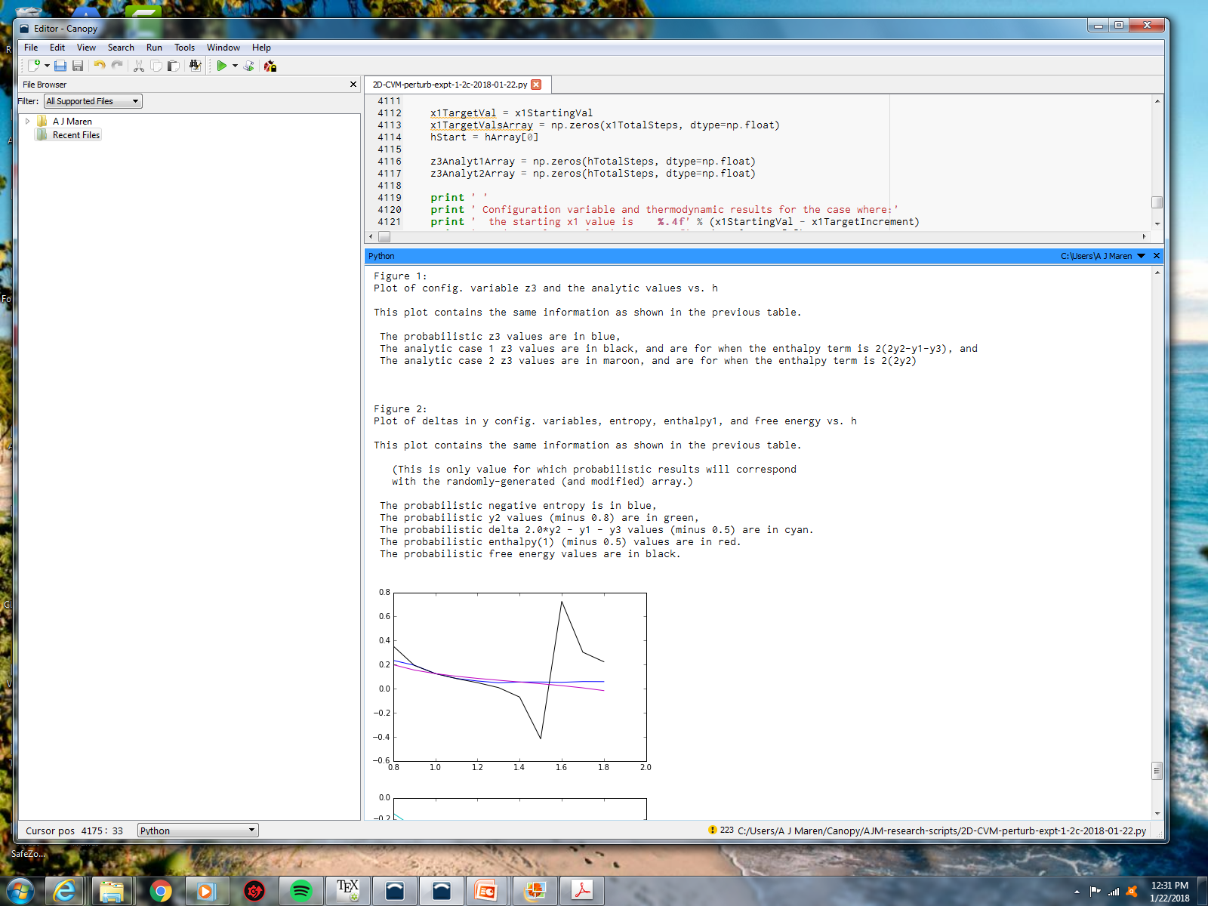
Configuration Variables and Analytic Results
x1= 0.50, h = 0.8 to 1.8

Slide 23
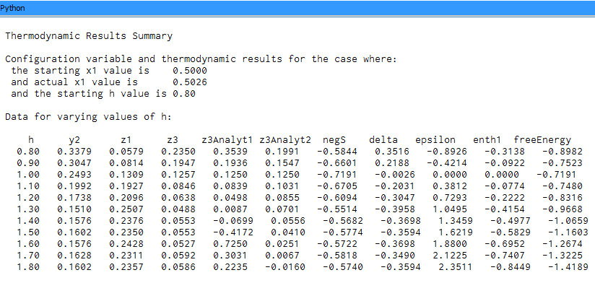
Configuration Variables and Analytic Results
x1= 0.50, h = 0.8 to 1.8

Slide 24
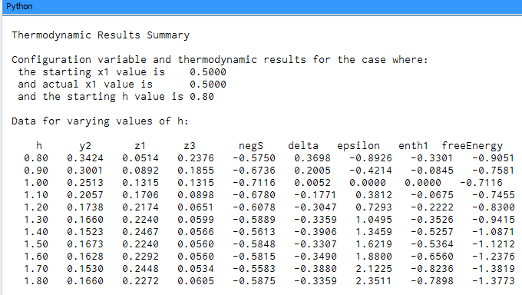
Experimental Results
x= 0.50 (so h0 = 0), h1 = h = 0.8 .. 1.8, and step size = 0.1

Slide 25
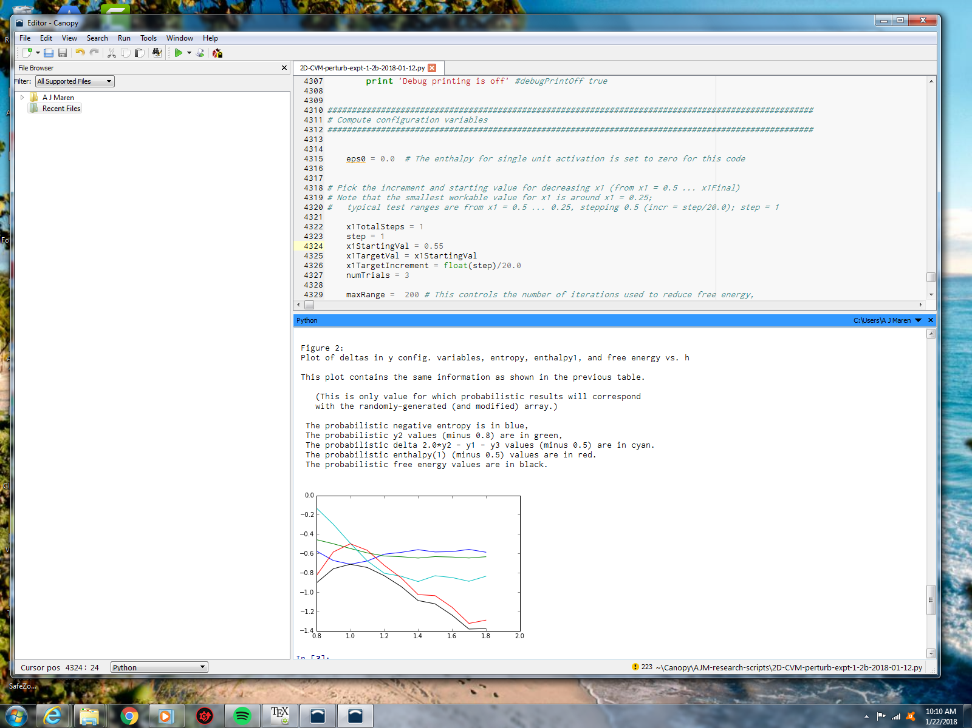
Experimental Results
x1= 0.50, h = 0.8 to 1.8

Slide 26
Configuration Variables and Thermodynamic Results
x1= 0.50, h = 0.8 to 1.8
delta =
2y₂ – y₁ – y₃ – 0.5
y₂ – 0.8
enthalpy – 0.5
neg-entropy
free energy
y₂, delta, and enthalpy all have scalars subtracted to bring them into the same visual field as entropy and free energy.
h-value

Slide 27
Experimental Series #1:
Extreme Rich Club; x₁ = x₂ = 0.5
Programs Used:
2D-CVM_def-pttrns_anlytc-FE-vary-e0-and-e1_2018-12-12.py
2D-CVM_def-pttrns_anlytc-FE-vary-e0-and-e1_v1pt1_2018-12-29.py
2D-CVM_def-pttrns_anlytc-FE-vary-e0-and-e1_v1pt3_2018-12-29.py
Repository (Private):
https://github.com/ajmaren/2-D-CVM-Defined-Pattern-Configurations

Slide 28
For Reference: An Extreme Rich Club-Like Composition: Code Validation
z₁ = Z₁/(2xN) = 214/(512) = 0.4180
z₃ = Z₃/(2xN) = 10/(512) = 0.0195
Hand-counted z₁ and z₃ values:
Code validation step
Approximate h-value: 1.65
NOTE: Hand-crafted pattern has equal values for z₁ & z₆, etc., so the h-value corresponds to the hand-counts. However: the analytic solution diverges as h gets larger.
Program: 2D-CVM_defined-patterns_analytic-solution_2017-12-08_rev_2018-11-22.py
Run Date: 11/23/2018 Private GitHub: 2-D-CVM-Random-Pattern-Configurations

Slide 29
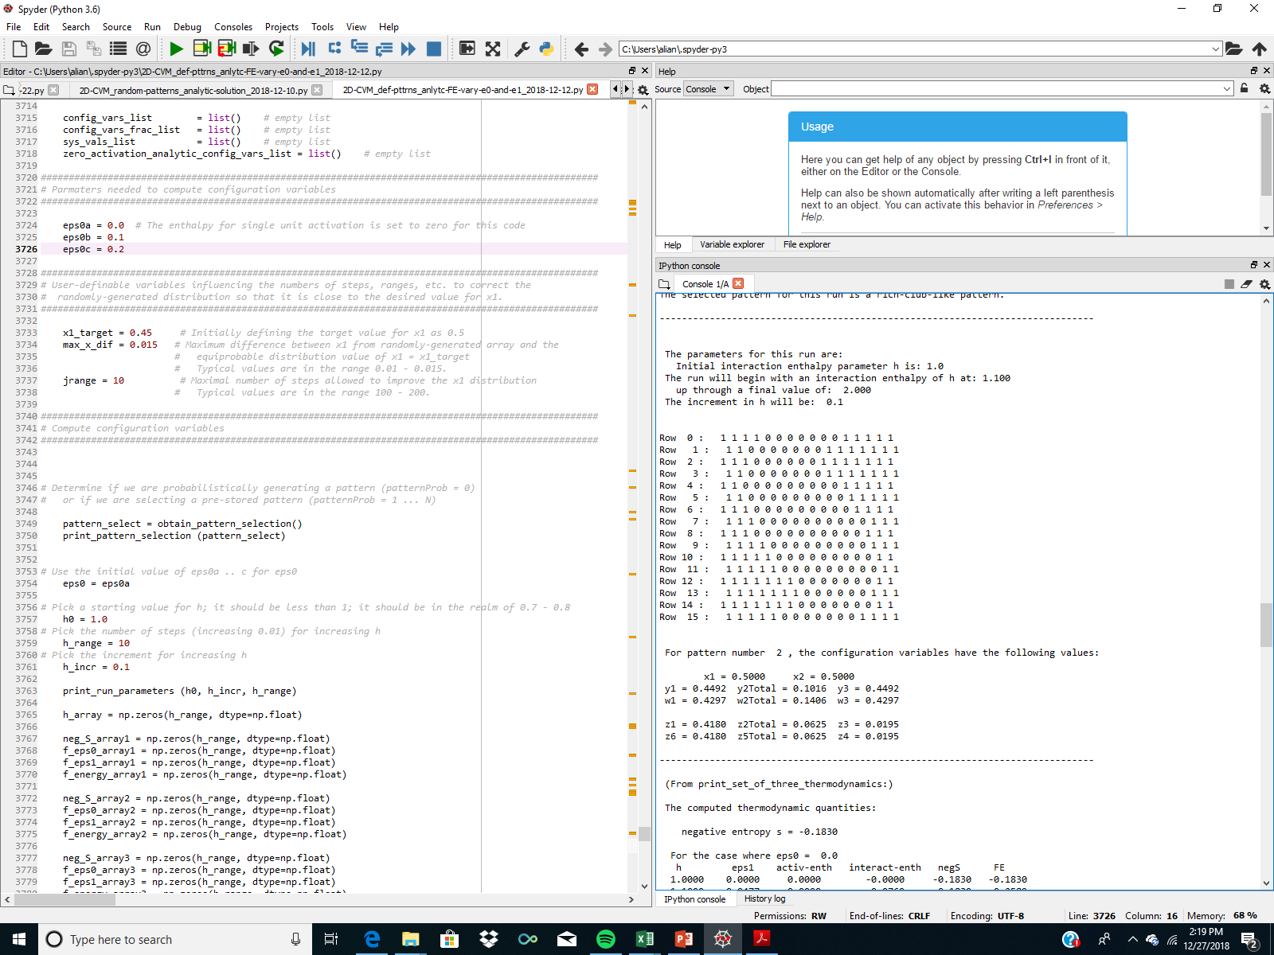
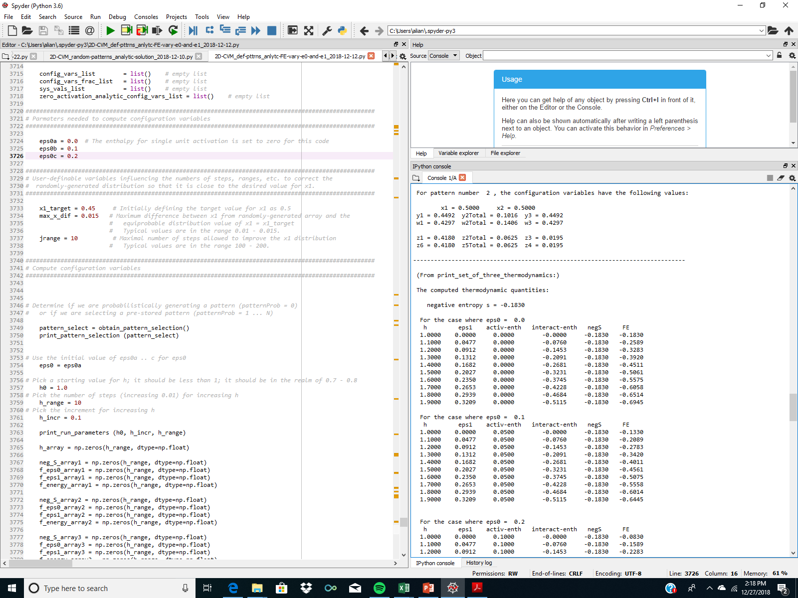
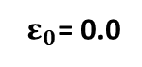
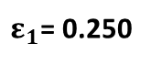
Illustration of Grid Computation for the
First Rich Club Pattern: x1_target = 0.50
${ ε}_{0}$= 0.0
For h = 1.65:
${ ε}_{1}$= 0.250
x₁ = 0.500
y₂ = 0.047
z₁ = 0.418
z₃ = 0.020
Note: We can continue to decrease the FE by increasing interaction enthalpy parameter eps1; it linearly increases the negative value of the interaction enthalpy. However, it doesn’t SOLVE for a FE minimum.

Slide 30
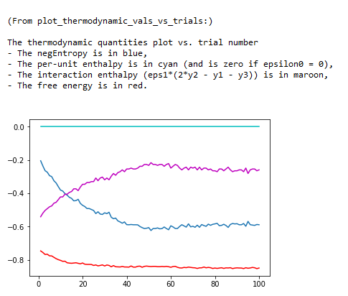
Trial 1

Slide 31
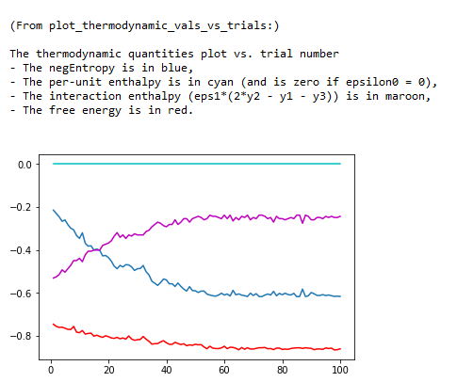
Trial 2

Slide 32
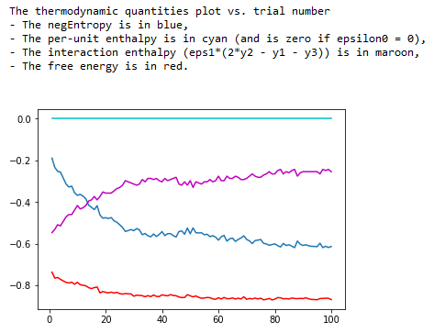
Trial 3

Slide 33
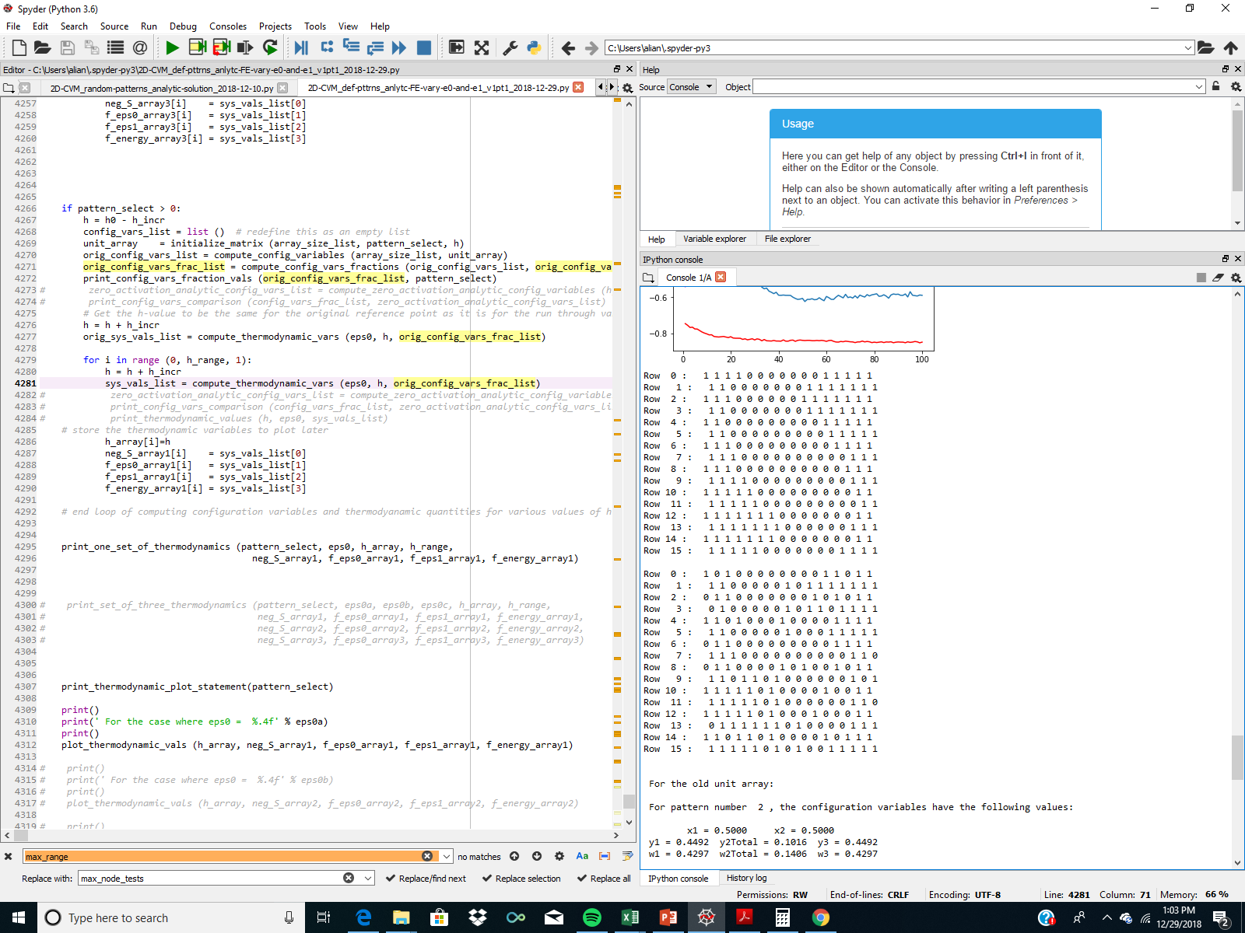
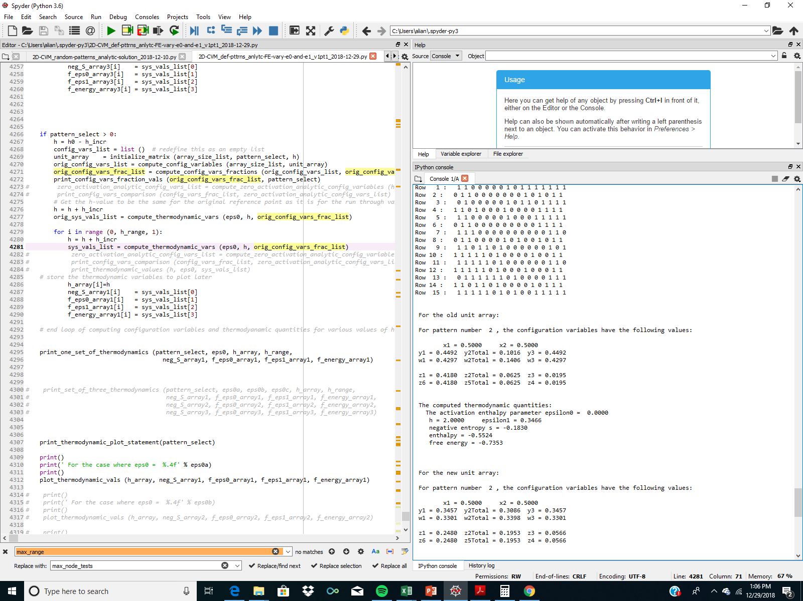

Free Energy Minimization Yields More Random / Diverse Pattern
To push towards the extreme separation of A and B nodes (on / off) shown in the Initial Grid, we set h = 2.0 (instead of previous h = 1.65).
There was still a lot of pattern change, resulting from the free energy minimization process.
Initial Grid
(Pattern 2)
Resulting Grid
(after 100 FE minimization steps)

Slide 34

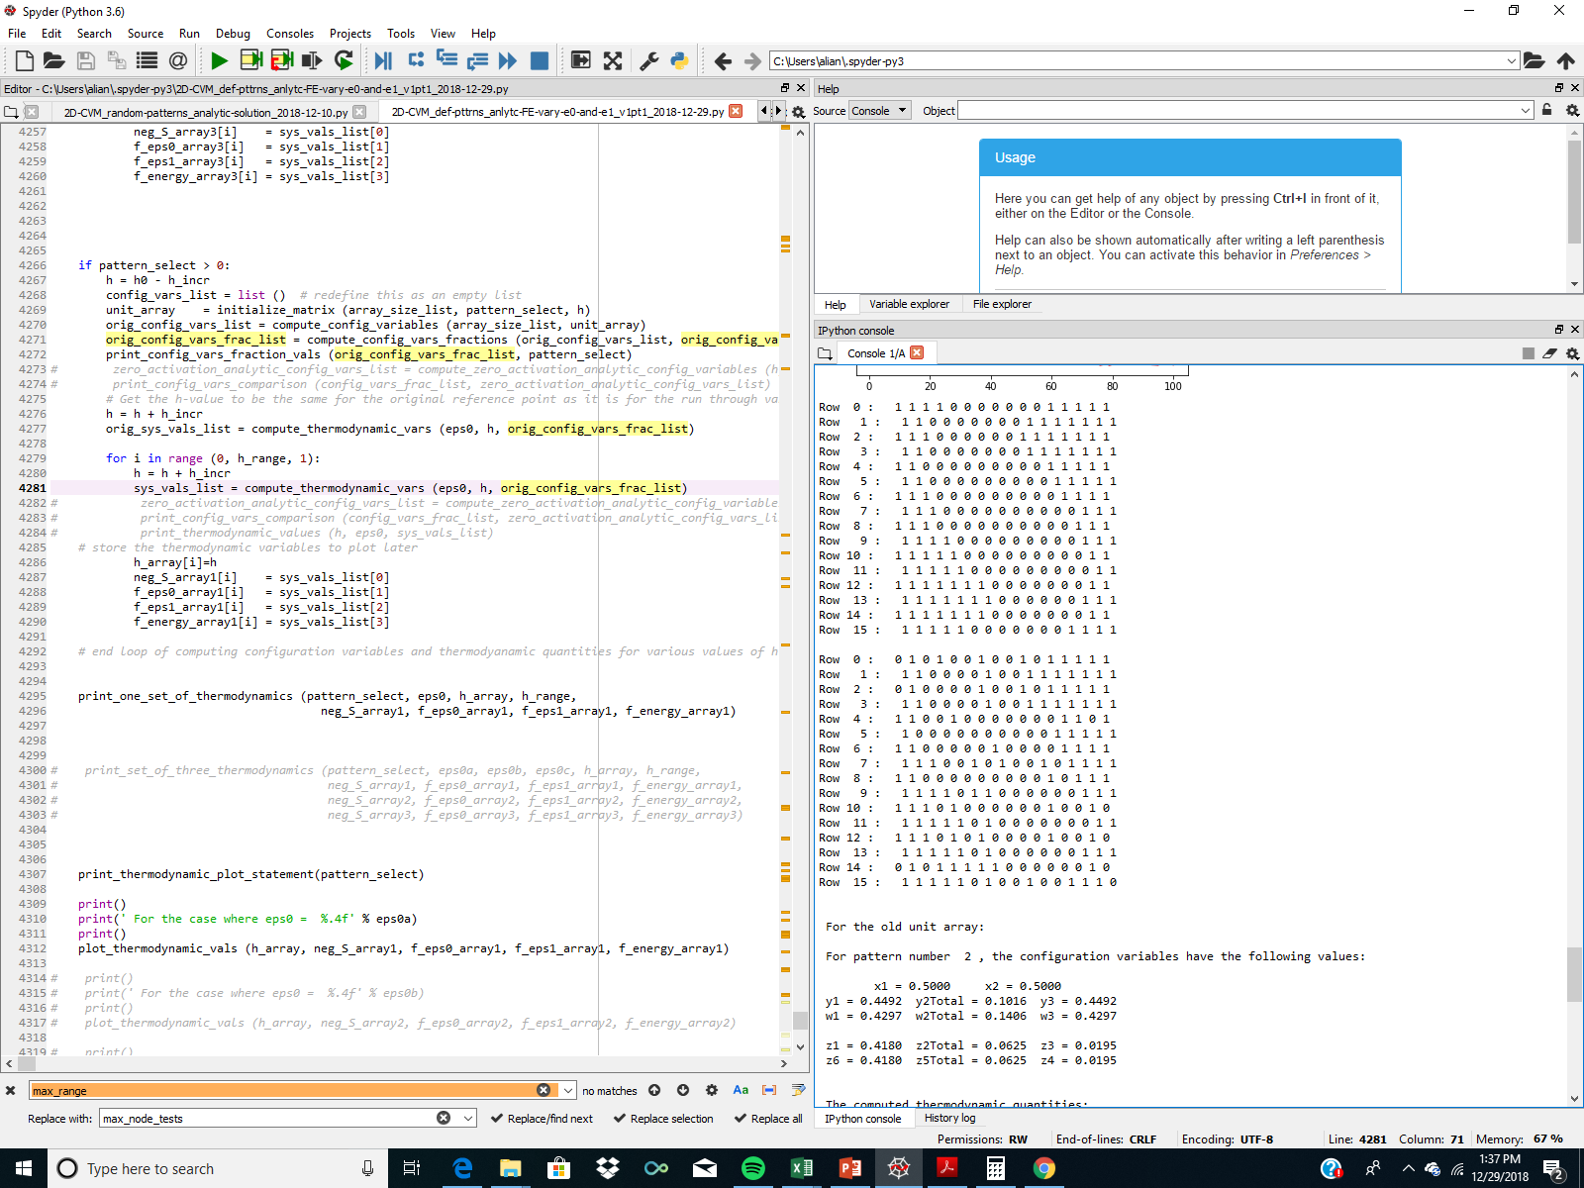


Free Energy Minimization Yields More Random / Diverse Pattern
Trial 2
(after 100 FE minimization steps)
Trial 3
(after 100 FE minimization steps)

Slide 35
Illustration, Part 1: Before Free Energy Minimization
Row 15*
*wrap-around
A Rich Club-Like Composition:
= 128 “A” (all connected)
and 128 “B” (connected)
Row 0
Row 1
Row 2
Row 3
Row 4
Row 5
Row 6
Row 7
Row 8
Configuration Variables
Row 9
Illustration based on counting the horizontal triplets only:
Row 10
Row 11
Row 12
z₁ = 214/(512) = 0.4180
Row 13
Row 14
z₃ = 10/(512) = 0.0195
Row 15

Slide 36
Illustration, Part 2: After Free Energy Minimization:
Example 1
A Modification from the Original Rich Club-Like Composition:
Row 15*
*wrap-around
Row 0
Configuration Variables
Row 1
Illustration based on counting the horizontal triplets only:
Row 2
Row 3
Row 4
Before FE Minimization:
Row 5
z₁ = 214/(512) = 0.4180
Row 6
z₃ = 10/(512) = 0.0195
Row 7
Row 8
After FE Minimization:
Row 9
z₁ = 0.2480
Row 10
z₁ is about half the original value
Row 11
Row 12
Row 13
z₃ = 0.0586
Row 14
z₃ is about triple the original value
Row 15

Slide 37
Quick Summary So Far:
Free Energy Minimization on a highly non-entropic pattern:
Dramatic decrease in the number of z1 (A-A-A) triplets
Dramatic increase in the number of z3 (A-B-A) triplets
Corresponding dramatic increase in the negentropy
And a decrease in the interaction enthalpy
Overall: we can reduce the free energy by increasing the negative entropy, with a small loss to the (negative value) of the interaction enthalpy.
This is a little bit different from what we thought we’d get with the original analytic computations.

Slide 38
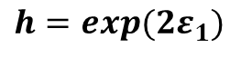
Recall Previous Analytic Results:
Analytic Values for Configuration Variables y₂, z₁, and z₃
Extreme Rich Club-Like Pattern
B
A
A
Z₃:
Z₁:
y₂:
B
B
A
A
A
A
A
Rich Club-Like
Configuration variable
y₂
z₃
For h = 2.00:
Rich Club-Like
y₂ = 0.005
h = 2.00
(ε₁ = 0.3466)
z₁ = 0.418
z₁
z₃ = 0.020
h: interaction enthalpy parameter;
$${ h=exp(2ε}_{1})$$

Slide 39
Our Analytic Predictions vs. Computational Results:
Configuration Variable | Analytic Prediction | Computational Result
y₂ (Average for each y₂; not total) | 0.051 | 0.154
z₁ | 0.408 | 0.248
z₃ | 0.020 | 0.057
Analytic Results: Configuration Variables vs. h
Black line is the analytic results for z₃ with the interaction enthalpy equation that we’re using; shows divergence with increase in h.
(This likely needs to be updated.)

Slide 40
Average of Three Trials
(with 100 trial-steps each for reducing free energy)
eps0 = 0; h = 2.0 (eps1 = 0.3466)
 | Initial | Trial 1 | Trial 2 | Trial 3 | Average (Trials 1 – 3)
x1 (const.) | 0.500 | 0.500 | 0.500 | 0.500 | 0.500
y2*2 | 0.1016 | 0.3086 | 0.3203 | 0.3086 | 0.3125
z1 | 0.4180 | 0.2480 | 0.2500 | 0.2500 | 0.2494
z3 | 0.0195 | 0.0566 | 0.0703 | 0.0664 | 0.0644
Activ-enth (const.) | 0.0 | 0.0 | 0.0 | 0.0 | 0.0
Interact-enth. | -0.5524 | -0.2653 | -0.2491 | -0.2653 | 0.2599
negS | -0.1830 | -0.5880 | -0.6162 | -0.6041 | 0.6028
Free Energy | -0.7353 | -0.8533 | -0.8653 | -0.8695 | -0.8625

Slide 41
Experimental Series #2:
Scale Free-Like; x₁ = x₂ = 0.5
Programs Used:
2D-CVM_def-pttrns_anlytc-FE-vary-e0-and-e1_2018-12-12.py
2D-CVM_def-pttrns_anlytc-FE-vary-e0-and-e1_v1pt1_2018-12-29.py
2D-CVM_def-pttrns_anlytc-FE-vary-e0-and-e1_v1pt3_2018-12-29.py
Repository (Private):
https://github.com/ajmaren/2-D-CVM-Defined-Pattern-Configurations

Slide 42
Row 15*
*wrap-around
A Scale-Free-Like Pattern
Configuration Variables
 | Z₁ | Z₃
A = black; B = white Counts for EACH row | A / \ A A | B / \ A A
Row 0 to Row 1 Row 14 to Row 15 | 2+3=5 | (1+0=1)*2 = 2
Row 1 to Row 2 Row 13 to Row 14 | 2+3=5 | (1+1=2)*2 = 4
Row 2 to Row 3 Row 12 to Row 13 | 3+3=6 | (1+0=1)*2 = 2
Row 3 to Row 4 Row 11 to Row 12 | 3+3=6 | (0+1=1)*2 = 2
Row 4 to Row 5 Row 10 to Row 11 | 4+4=8 | (0+1=1)*2 = 2
Row 5 to Row 6 Row 9 to Row 10 | 5+4=9 | (0+0=0)*2 = 0
Row 6 to Row 7 Row 8 to Row 9 | 1+2=3 | (3+0=3)*2 = 6
Row 7 to Row 8 Row 15 to Row 0 | 1+1=2 | 1+1=2 2+2 = 4
Sum x 2 | 88 | 24
Row 0
Row 1
Row 2
Row 3
Row 4
Row 5
Row 6
Row 7
Row 8
Row 9
Row 10
Row 11
Row 12
Row 13
Row 14
Row 15
For Rows 0 .. 7
A
A
A
For Rows 14 .. 8 & 15
+
A
+
A
A
z₁ = Z₁/(2xN) = 88/(512) = 0.172
Z₁ for Row N to N+1 =
A
A
A
Z₁ for Row N to N+1 =
A
A
A
z₃ = Z₃/(2xN) = 24/(512) = 0.0469
A
A
B
B
A
A
Z₃ for Row N to N+1 =
+
Z₃ for Row N to N+1 =
+
B
A
A
A
A
B

Slide 43
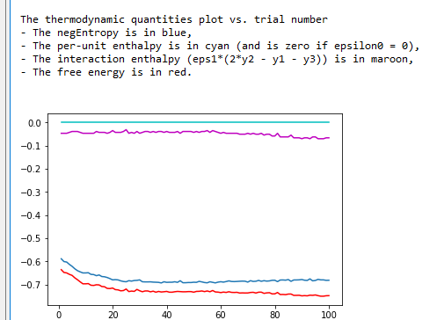
Scale Free-Like: Trial 2.a
2D-CVM_def-pttrns_anlytc-FE-vary-e0-and-e1_v1pt3_2018-12-29.py
01/12/2019

Slide 44
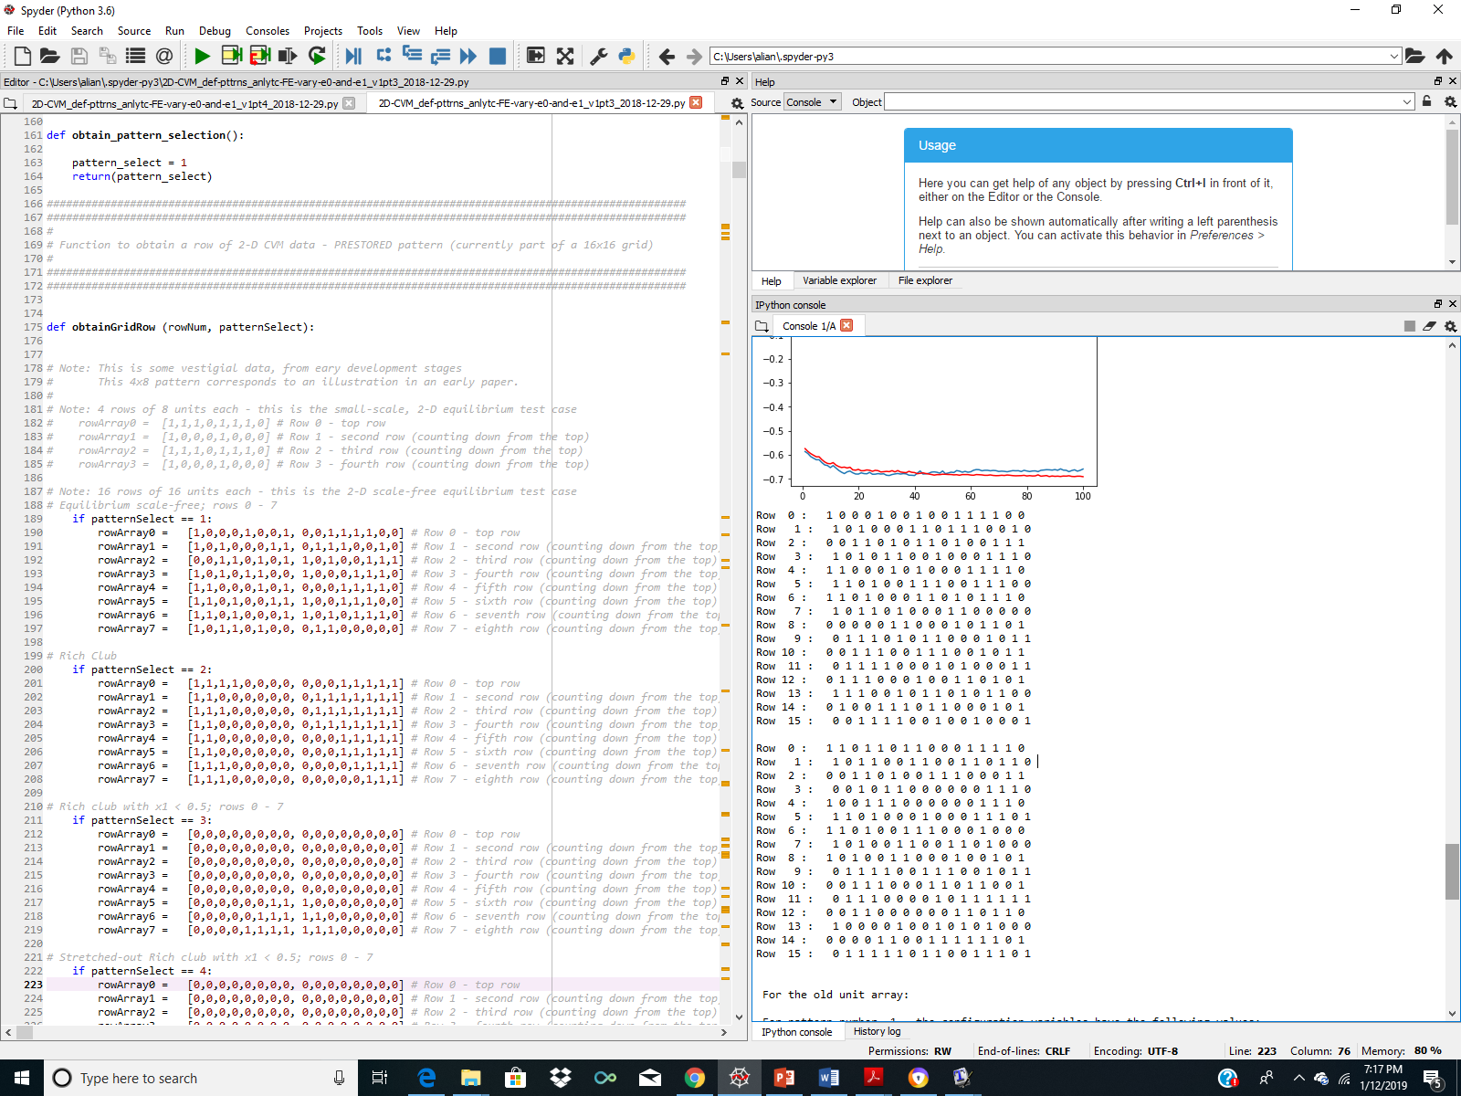
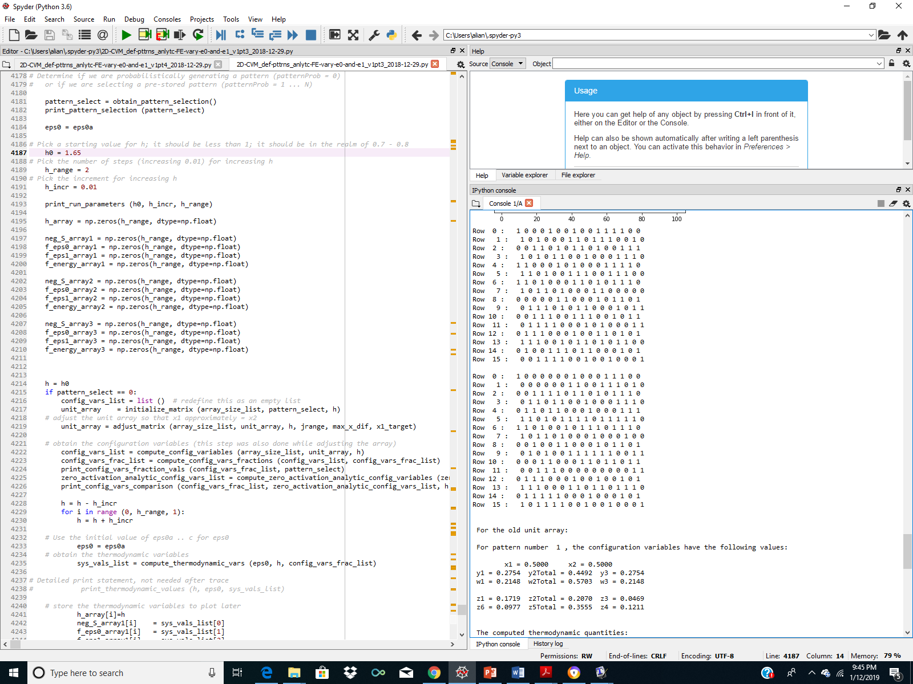

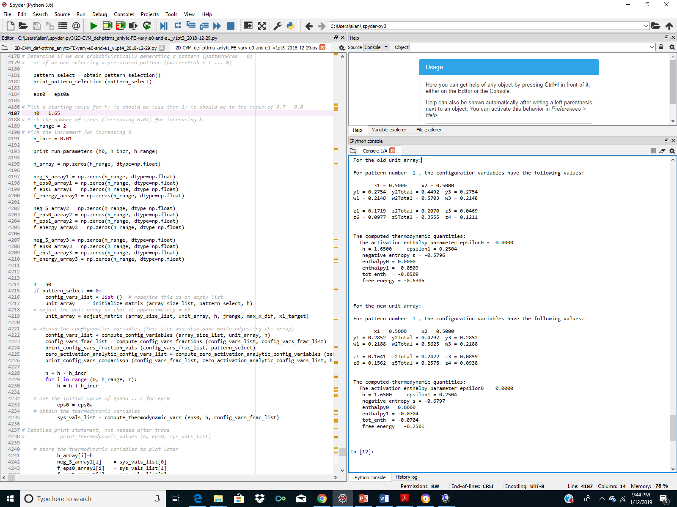
Free Energy Minimization Yields More Contiguously-Clustered Pattern: Trial 2.a
Initial Grid
(Pattern 1: Scale Free-Like)
Resulting Grid
(after 100 FE minimization steps)

Slide 45
Row 15*
*wrap-around
Initial Grid: A Scale-Free-Like Pattern
Configuration Variables
 | Z₁ | Z₃
A = black; B = white Counts for EACH row | A / \ A A | B / \ A A
Row 0 to Row 1 Row 14 to Row 15 | 2+3=5 | (1+0=1)*2 = 2
Row 1 to Row 2 Row 13 to Row 14 | 2+3=5 | (1+1=2)*2 = 4
Row 2 to Row 3 Row 12 to Row 13 | 3+3=6 | (1+0=1)*2 = 2
Row 3 to Row 4 Row 11 to Row 12 | 3+3=6 | (0+1=1)*2 = 2
Row 4 to Row 5 Row 10 to Row 11 | 4+4=8 | (0+1=1)*2 = 2
Row 5 to Row 6 Row 9 to Row 10 | 5+4=9 | (0+0=0)*2 = 0
Row 6 to Row 7 Row 8 to Row 9 | 1+2=3 | (3+0=3)*2 = 6
Row 7 to Row 8 Row 15 to Row 0 | 1+1=2 | 1+1=2 2+2 = 4
Sum x 2 | 88 | 24
Row 0
Row 1
Row 2
Row 3
Row 4
Row 5
Row 6
Row 7
Row 8
Row 9
Row 10
Row 11
Row 12
Row 13
Row 14
Row 15
For Rows 0 .. 7
A
A
A
For Rows 14 .. 8 & 15
+
A
+
A
A
z₁ = Z₁/(2xN) = 88/(512) = 0.172
Z₁ for Row N to N+1 =
A
A
A
Z₁ for Row N to N+1 =
A
A
A
z₃ = Z₃/(2xN) = 24/(512) = 0.0469
A
A
B
B
A
A
Z₃ for Row N to N+1 =
+
Z₃ for Row N to N+1 =
+
B
A
A
A
A
B

Slide 46
Scale-Free-Like Pattern after Free Energy Minimization
Experimental Series 2: Scale Free-Like Pattern
Trial 2.a (h = 1.65)
(Note: this is larger than the estimated equilibrium h-value)
A Modification from the Original Scale Free-Like Composition:
Row 15*
*wrap-around
Row 0
Configuration Variables
Row 1
Row 2
Before FE Minimization:
Row 3
z₁ = 88/512 = 0.1719
Row 4
z₃ = 24/(512) = 0.0469
Row 5
Row 6
After FE Minimization:
Row 7
z₁ = 0.1614
Row 8
Row 9
z₁ is slightly decreased from the original value
Row 10
Row 11
z₃ = 0.0859
Row 12
z₃ is about double the original value – more A-B-A triplets
Row 13
Row 14
Row 15

Slide 47
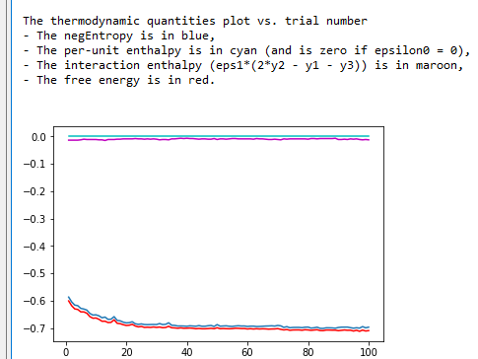
Scale Free-Like: Trial 2.b
2D-CVM_def-pttrns_anlytc-FE-vary-e0-and-e1_v1pt3_2018-12-29.py
01/12/2019

Slide 48
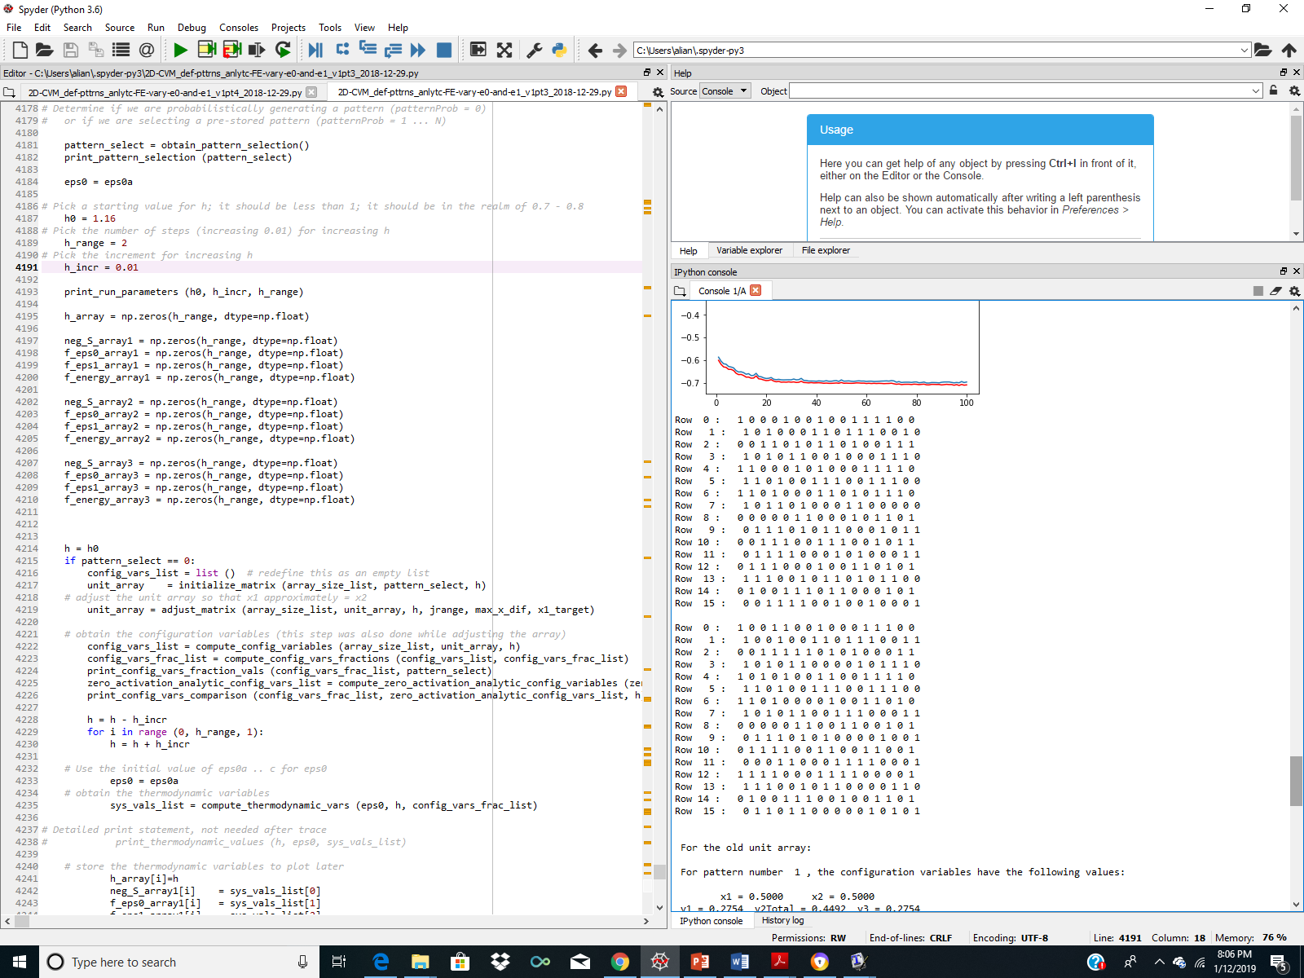
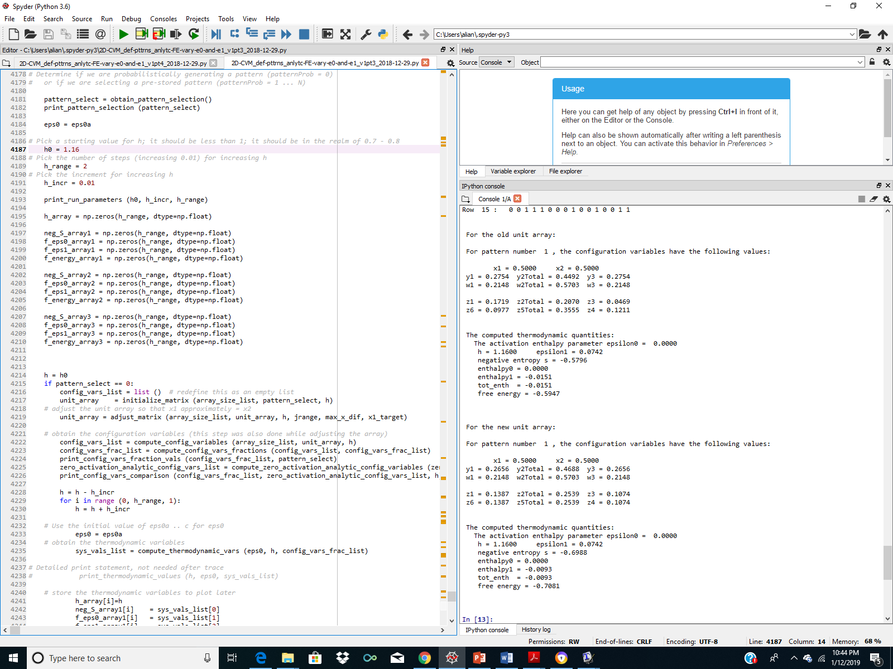
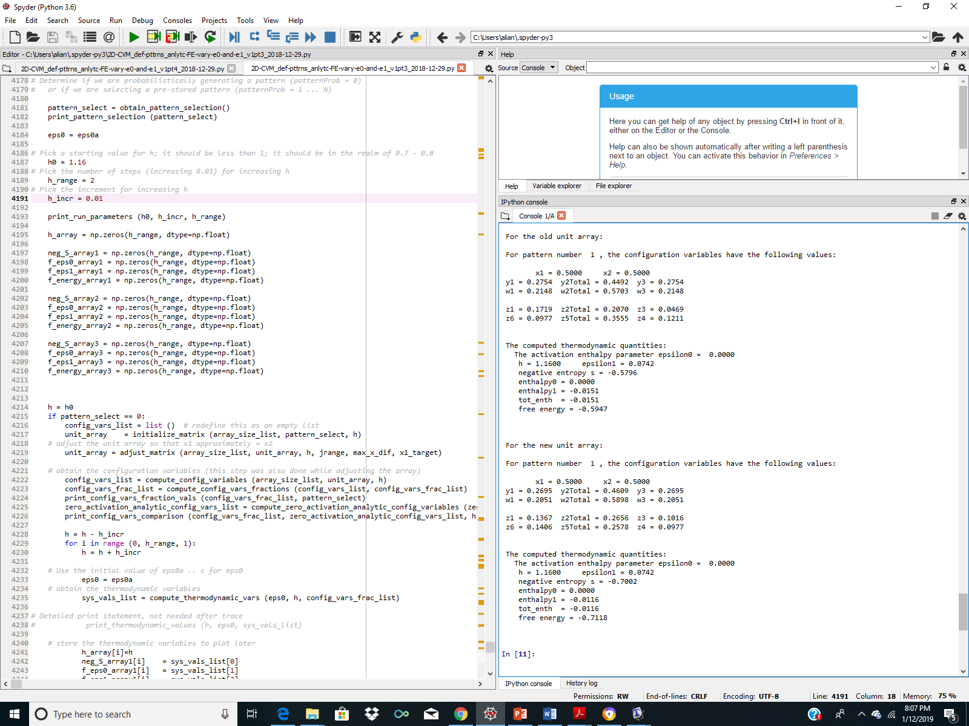
Free Energy Minimization Yields More Contiguously-Clustered Pattern: Trial 2.b
Initial Grid
(Pattern 1: Scale Free-Like)
Resulting Grid
(after 100 trials)

Slide 49
Scale Free-Like Pattern after Free Energy Minimization:
Experimental Series 2: Scale Free-Like Pattern
Trial 2.b (h = 1.16)
(Note: this is the estimated equilibrium h-value)
A Modification from the Original Scale Free-Like Composition:
Configuration Variables
Row 0
Row 1
Before FE Minimization:
Row 2
z₁ = 88/512 = 0.1719
Row 3
Row 4
z₃ = 24/(512) = 0.0469
Row 5
Row 6
After FE Minimization:
Row 7
z₁ = 0.1367
Row 8
z₁ is slightly decreased from the original value – fewer A-A-A triplets
Row 9
Row 10
Row 11
Row 12
z₃ = 0.1016
Row 13
z₃ is more than double the original value – more A-B-A triplets
Row 14
Row 15

Slide 50
Experimental Series #3:
Slightly Smaller Rich Club x₁ = 0.45
Programs Used:
2D-CVM_def-pttrns_anlytc-FE-vary-e0-and-e1_v1pt1_2018-12-29.py**
(Will need follow-on program to this for variance in eps0)
Repository:
https://github.com/ajmaren/2-D-CVM-Defined-Pattern-Configurations

Slide 51
Row 15*
*wrap-around
A Slightly Smaller Rich Club-Like Composition:
x1_target = 0.45
= 115 “A” (all connected)
and 141 “B” (connected)
(Note: 0.45*256 = 115.2)
Original configuration had 128 “A” nodes; so convert 13 of these to “B”
Row 0
Row 1
Row 2
Row 3
Row 4
Row 5
Row 6
Expected eps0 approx. 0.2
Expected eps1 approx. 1.65
Row 7
Row 8
Row 9
Row 10
Row 11
Row 12
Row 13
Row 14
Row 15

Slide 52



Illustration of Grid Computation for the
Slightly Smaller Rich Club Pattern: x1_target = 0.45
${ ε}_{0}$= 0.0
For h = 1.65:
${ ε}_{1}$= 0.250
x₁ = 0.450
y₂ = 0.051
z₁ = 0.367
z₃ = 0.0195
?
Note: We can continue to decrease the FE by increasing interaction enthalpy parameter eps1; it linearly increases the negative value of the interaction enthalpy. However, it doesn’t SOLVE for a FE minimum.

Slide 53
Code Functionality
Programs Used:
2D-CVM_def-pttrns_anlytc-FE-vary-e0-and-e1_v1pt1_2018-12-29.py*
(*This first program has eps0 = 0)
2D-CVM_def-pttrns_anlytc-FE-vary-e0-and-e1_v1pt3_2018-12-29.py**
(**This program finds a free energy minimum given a defined starting pattern, and specified values for eps0 and eps1)
Repository (for PPT; v1.3 code not available yet):
https://github.com/ajmaren/2-D-CVM-Defined-Pattern-Configurations

Slide 54
Experimental Specification:
Functionality:
This code still has the old “random pattern” capabilities in it, but is used for defined pattern experiments
Pattern 3 is a tightly convex (circle) of 30 A nodes in a sea of B
30 A nodes gives 30/256 = x₁ = 0.119 (actually, 30.464 nodes)
The corresponding case (with eps1 = 0) would have eps0 = 2.0 (see next slide)
Thus, when we run the thermodynamics, we should get the free energy minimum when eps0 is close to 2.0
And the eps1 should be in the neighborhood of 0.256 (h = exp(2*beta*eps1; per Kikuchi-Brush 1967, and beta=1, so h = exp(0.512) = 1.669)
Code Source and Documentation:
GitHub Private Repository:
https://github.com/ajmaren/2-D-CVM-Defined-Pattern-Configurations
Code:
2D-CVM_def-pttrns_anlytc-FE-vary-e0-and-e1_2018-12-12.py
Documentation:
TBD

Slide 55



This Gives Us A New Point in the Phase Space
For the case where epsilon1 = 0 (no interaction enthalpy), we are working across the top axis of this graph.
We solve for each value of x1 computationally, as a result of setting the derivative of the free energy equal to zero for a given value of the activation enthalpy eps0.
$${ ε}_{0}$$
0.0
1.0
2.0
3.0
4.0
5.0
x₁
0.500
0.269
0.119
0.047
0.018
0.007
h is the Activation Enthalpy Parameter; h = exp(2.0*eps0)
0.0
We know this point:
${ ε}_{0}$= 1.0
0.1
0.500
For h = 1.0:
${ ε}_{1}$= 0.0
x₁ = 0.269
0.2
0.500
We want this point:
(location in phase space unknown)
(Interaction Enthalpy Parameter)
FE = -0.313
0.3
0.500
0.4
0.500
$${ ε}_{1}$$
0.5
0.500

Slide 56
Experimental Specification: Very Small Rich Club
Create a small cluster of “A” nodes in a sea of “B,” and computationally identify the (eps0, eps1) values that yield the free energy minimum associated with this pattern.
x₁ vs epsilon₀ (Activation Enthalpy Parameter) and epsilon₁ (Interaction Enthalpy Parameter)
epsilon₀ (Activation Enthalpy Parameter)
0.0
1.0
2.0
3.0
4.0
5.0
x₁
0.500
0.269
0.119
0.047
0.018
0.007
0.0
Starting Experimental Specifications:
Eps0 = 2.0 => x1_target = 0.119
X1_actual (defined pattern) = 0.119*256 = 30.46
Or X1_actual => 30
=> Generate a pattern where X₁ = 30
Expected values for FE minimum:
eps0 near 2.0
eps1 near 0.25, or h near 1.65
However: We don’t know exactly which values for (eps0, eps1) will produce a free energy minimum for this specified pattern
0.1
0.500
We want to position a point approximately here:
0.2
0.500
epsilon₁ (Interaction Enthalpy Parameter)
0.3
0.500
0.4
0.500
0.5
0.500

Slide 57
A “rich club” of only 30 “A” Nodes; all connected
A Very Small Rich Club:
= 30 “A” (all connected)
and 226 “B” (connected)
Row 15*
*wrap-around
Row 0
Configuration Variables
Row 1
Horizontal Triplets | Z₁ | Z₃
A = black; B = white Counts for EACH row | A / \ A A | B / \ A A
Row 0 to Row 1 Row 14 to Row 15 | (0+0=0) *2 = 0 | (0+0=2)*2 = 0
Row 1 to Row 2 Row 13 to Row 14 | (0+0=0) *2 = 0 | (0+0=0)*2 = 0
Row 2 to Row 3 Row 12 to Row 13 | (0+0=0) *2 = 0 | (0+0=0)*2 = 0
Row 3 to Row 4 Row 11 to Row 12 | (0+0=0) *2 = 0 | (0+0=0)*2 = 0
Row 4 to Row 5 Row 10 to Row 11 | (0+0=0) *2 = 0 | (0+2=2)*2 = 4
Row 5 to Row 6 Row 9 to Row 10 | (2+3=5) *2 = 10 | (0+1=1)*2 = 2
Row 6 to Row 7 Row 8 to Row 9 | (4+5=9) *2 = 18 | (0+1=1)*2 = 2
Row 7 to Row 8 Row 15 to Row 0 | 6+6=12 0+0 = 0 | 0+0=0 0+0 = 0
Sum | 40 | 8
Row 2
Row 3
Row 4
Row 5
Row 6
Row 7
Row 8
Row 9
Row 10
Row 11
Row 12
Row 13
Row 14
Row 15
Illustration based on counting the horizontal triplets only:
z₁ = Z₁/(2xN) = 38/(512) = 0.742
z₃ = Z₃/(2xN) = 8/(512) = 0.0156

Slide 58

Experimental Configurations for variable (eps0, eps1): Trial #1
“Very Small Rich Club”
Repository (Private):
Code: 2D-CVM_def-pttrns_anlytc-FE-vary-e0-and-e1_2018-12-12.py
Pattern: 3
Check that hand-computed z values match the code-computed ones
Hand-computed configuration values:
Z1 = 40; z1 = 40/512 = 0.0781; matches
Z3 = 8; z3 = 8/512 = 0.0156; matches.
Next step: Find the (eps0, eps1) pair yielding a free energy minimum for this grid pattern

Slide 59
Summary of Experimental Results:
The program(s) available were not able to generate a free-energy minimized pattern:
This is an earlier effort, and the programs have been updated since.
The experiment has not been repeated, though.
The real problem was that it was not possible to adequately estimate initial values for h₀ and h₁.
This is because the thermodynamic variables diverge strongly from the analytic result (for the case where h₀ = 0), and we have no idea of what the the combinations of the h-values will yield for higher values of h₀ and h₁.
The best approach is to work the edges of the phase space first, and then work towards the interior.

Slide 60
Experimental Series #4 and 5:
Variational Bayes Using Two Grid Sizes
Programs Used:
2D-CVM_def-pttrns_anlytc-FE-vary-e0-and-e1_2018-12-12.py
2D-CVM_def-pttrns_var-Bayes_v1pt1_lg-grid_2019-01-19.py
Repository:
https://github.com/ajmaren/2-D-CVM-Defined-Pattern-Configurations
(Private repository)

Slide 61
Experimental Series #4:
Original Scale-Free Pattern Replicated in Large Grid

Slide 62
Computational Results for a Psi-r-q System:
External realm (Psi), Representation (r), and Model (q)
Representational System (r):
2-D CVM 16x16 grid
Scale-free-like system
External System (Psi):
2-D CVM 32x32 grid; also scale-free-like
Experiment #4: Pattern 6 is created by assembling four instances of the pattern used in r.
Experiment #5: Pattern 7 is created by manually adjusting the grid configuration to be more scale-free-like
Model System (q):
2-D CVM 16x16 grid (originally the same as r)
Achieved by bringing r into free energy equilibrium
We can compute configuration variables and thermodynamic quantities for the Psi, r, and q systems.

Slide 63
(b)
(a)
Grid (a) revised to ensure equiprobability, 2019-01-16
Right-most unit in Row 14 and left-most in Row 17 changed to 0 (B)
Pattern 6 in 2D-CVM_def-pttrns_var-Bayes_v1pt1_lg-grid_2019-01-19.py
As of 2019/03/19, this code is not yet publicly available.

Slide 64

Original Observed Values for the Configuration Variables in Pattern 6 (Psi)
(Large Scale-Free-Like System)
Observed Values Shown against Analytic Values for Configuration Variables y₂, z₁, and z₃
Case where activation enthalpy : x₁ = x₂ = 0.5
$${ ε}_{0}=0$$
B
A
A
y₂
Z₃:
Z₁:
y₂:
B
B
A
A
A
A
A
z₁
Configuration variable
z₃
y₂
z₁
Observed Configuration Variable Values:
Pattern 6
z₃
y₂ = 0.224
z₁ = 0.176
z₃ = 0.053
h: interaction enthalpy parameter;
$${ h=exp(2ε}_{1})$$

Slide 65
Original Observed Values for the Configuration Variables in Pattern 6 (Psi)
(Large Scale-Free-Like System)
The observed values for the configuration variables y₂, z₁, and z₃ occur at different h-values.
y₂ = 0.224; h (approx.) = 1.165
z₁ = 0.176; h (approx.) = 1.195
z₃ = 0.053; h (approx.) = 1.45
This indicates that the system is not at equilibrium.
If the system WERE at equilibrium, the configuration variable values would line up at or near a single h-value.
We will see a more consistent h-value after we conduct free energy minimization.
Just for fun, we set h= 1.165 for the free energy minimization process.
This should result in:
Keeping the y₂ value about where it is (approximately the same number of A-B and B-A nearest neighbors).
Decreasing z₁ a little (from 0.176 to about 0.15 – 0.16), meaning fewer A-A-A triplets, and
Increasing z₃ a lot (from 0.053 to about 0.1), meaning more A-B-A triplets.

Slide 66

Original (Pattern 6 – Large Scale-Free)

Slide 67

New – Evolution of Pattern 6
(After Free Energy Equilibrium Achieved)

Slide 68
New – Evolution of Pattern 6
(Showing Flipped Nodes – Rows 0 – 2 Only – for illustration)
In rows 0 – 2 (3x32 = 96 nodes total), 9 nodes were flipped as the system was brought to free energy equilibrium; approximately 10% of the total nodes.

Slide 69
Complete Evolution of Pattern 6 after FE Minimization
(Showing Flipped Nodes – All Rows)
Complete set of nodes that were flipped as the system was brought to free energy equilibrium; 108 out of 1024 nodes, or approximately 10% of the total nodes (10.55%).

Slide 70
The Original Pattern 6 Large-Scale Grid (Before FE Minimization)
(b)
(a)
Grid (a) revised to ensure equiprobability, 2019-01-16
Right-most unit in Row 14 and left-most in Row 17 changed to 0 (B)
Pattern 6 in 2D-CVM_def-pttrns_var-Bayes_v1pt1_lg-grid_2019-01-19.py
As of 2019/03/19, this code is not yet publicly available.

Slide 71
The Resulting Pattern 6 Large-Scale Grid (After FE Minimization)
(b)
(a)
Comparing the resultant free energy-minimized pattern
against the original scale-free-like pattern (Pattern 6; shown here)
(previous slide)

Slide 72

Evolution of Free Energy Minimum
The free energy minimum is largely achieved after 40 – 60 time steps.
The experimental run was conducted over 100 time steps.

Slide 73

Configuration Variables and Thermodynamic Quantities
After Free Energy Minimum has been Achieved
h is set to 1.165 (see the equilibrium plot for the original observed values for the configuration variables).

Slide 74
After Free Energy Minimization: Computational Results when h = 1.165
Pattern 6 – Large Scale-Free (4 Simple Repeats of Small-Scale Grid)
Computational Values for Configuration Variables y₂, z₁, and z₃
Case where activation enthalpy : x₁ = x₂ = 0.5
$${ ε}_{0}=0$$
B
A
A
y₂
Z₃:
Z₁:
y₂:
B
B
A
A
A
A
A
z₁
Configuration variable
z₃
y₂
z₁
h = 1.165 (for expts)
z₃
For h = 1.165:
y₂ = 0.231
z₁ = 0.157
z₃ = 0.091
h: interaction enthalpy parameter;
$${ h=exp(2ε}_{1})$$

Slide 75
Original Observed Values for the Configuration Variables in Pattern 6 (Psi)
(Large Scale-Free-Like System)
Just for fun, we set h= 1.165 for the free energy minimization process.
Configuration Variable | Original (Observed) | Anticipated (Approx.) | Actual (After Free Energy Minimization)
y₂ | 0.224 | 0.224 | 0.231
z₁ | 0.176 | 0.155 | 0.157
z₃ | 0.053 | 0.1 | 0.091
These results indicate that:
The system is much closer to a free energy minimum (and observing the results of node-flipping, we won’t get much better with continued node-flips),
The z₃ value is still a bit low (0.091, where equilibrium would be closer to 0.1), however – we now have more A-B-A triplets, and
The original “islands of A’s” are a bit more broken up; more inclusions of B within the A-masses (as indicated by increase in A-B-A triplets); the overall topography has changed.

Slide 76
Experimental Series #4:
Modified Scale-Free-Like Large Grid

Slide 77
Experiment #4 Used a Large-Scale Grid that Repeated Smaller Grid Four Times
(b)
(a)
Comparing the original scale-free-like pattern (Pattern 6; shown here)
with the free energy-minimized results (next slide)

Slide 78
Experiment #5 Uses a Large-Scale Grid with Revised Scale-Free-Like Pattern
Note: Smaller “islands” of A have been combined to form larger “land masses.”
(b)
(a)
Experimental Trial: Pattern 7, 2019-01-16
Pattern 7 in 2D-CVM_def-pttrns_var-Bayes_v1pt1_lg-grid_2019-01-19.py
As of 2019/03/19, this code is not yet publicly available.

Slide 79

Original Plan for the 16x16 Scale-Free Example
Original PPT lost; JPG stored in the V&V Figures as:
CVM-2D_Scale-free_128-nodes_pg0_2016-10-26.jpg
Under: 2D-CVM-Free-Energy-V-and-V/Figures

Slide 80
Plan for the 32x32 Scale-Free Example
32 x 32 = 1024 total nodes
= 512 per side (half of total; top or bottom)
= 512/2 = 256 black per top or bottom
256 = 4* 64
Scale Free Composition:
= 64 center = 64
= 2* 32 center = 64
+ 4* 16 = 64
+ 4* 8 = 32
+ 8* 4 = 32
For a total of 3*64 + 2*32= 192 + 64 = 256
Actual:
1 at 30 = 30
1 at 35 = 35
2 at 17 = 34
4 at 9 = 36
2 at 8 = 16
6 at 6 = 36
2 at 12 (inc wrap) / 2 = 12
2 at 4 (inc wrap)/2 = 04
12 at 4 = 48
Total: 251

Slide 81


We Identify a Likely h-value from the Configuration Variable Values
Results for a Given Pattern (Pattern 7; Large-Scale Grid)
Analytic Values for Configuration Variables y₂, z₁, and z₃
$${ ε}_{0}=0$$
Case where activation enthalpy : x₁ = x₂ = 0.5
B
A
A
y₂
Z₃:
Z₁:
y₂:
B
B
A
A
A
A
A
z₁
Configuration variable
z₃
y₂
h = 1.22 (initial pattern);
based on y₂ config var value
z₁
For Pattern 7:
z₃
y₂ = 0.202
z₁ = 0.212
z₃ = 0.058
h: interaction enthalpy parameter;
$${ h=exp(2ε}_{1})$$

Slide 82

Original Grid Configuration
Pattern 7, in 2D-CVM_def-pttrns_var-Bayes_v1pt1_lg-grid_2019-01-19.py

Slide 83

Resultant Grid after Free Energy Minimization (Expt. on Pattern 7)

Slide 84
Experiment #5: Pattern 7, before Free Energy Minimization
Note: Smaller “islands” of A have been combined to form larger “land masses.”
(b)
(a)
Experimental Trial: Pattern 7, 2019-01-16
Pattern 7 in 2D-CVM_def-pttrns_var-Bayes_v1pt1_lg-grid_2019-01-19.py
As of 2019/03/19, this code is not yet publicly available.

Slide 85
Experiment #5: Results after Free Energy Minimization of Large Grid
h = 1.2
(b)
(a)
Experimental Trial: Pattern 7, 2019-01-16
Pattern 7 in 2D-CVM_def-pttrns_var-Bayes_v1pt1_lg-grid_2019-01-19.py
As of 2019/03/19, this code is not yet publicly available.

Slide 86

Free Energy Minimization Results on Pattern 7 (Large-Scale Grid)
h-value = 1.20
Based on h-value (observed) corresponding to configuration variables for original Pattern 7

Slide 87

Computational Result when h = 1.21
Pattern 7, after Free Energy Minimization
Computational Values for Configuration Variables y₂, z₁, and z₃
Case where activation enthalpy : x₁ = x₂ = 0.5
$${ ε}_{0}=0$$
y₂
B
A
A
z₁
Z₃:
Z₁:
y₂:
B
B
A
A
A
A
A
z₃
Configuration variable
Original Pattern 7:
y₂
z₁
h = 1.20 (ε₁ = 0)
y₂ = 0.202
z₁ = 0.212
z₃
z₃ = 0.058
After FEMin;
h = 1.2:
y₂ = 0.224
z₁ = 0.164
z₃ = 0.094
h: interaction enthalpy parameter;
$${ h=exp(2ε}_{1})$$

Slide 88
Original Observed Values for the Configuration Variables in Pattern 7 (Psi)
(Large Scale-Free-Like System)
We set h= 1.20 for the free energy minimization process.
Configuration Variable | Original (Observed) | Anticipated (Approx.) | Actual (After Free Energy Minimization)
y₂ | 0.202 | 0.20 | 0.224
z₁ | 0.212 | 0.18 | 0.164
z₃ | 0.058 | 0.09 | 0.094
These results indicate that:
(Once again,) the system is much closer to a free energy minimum (and observing the results of node-flipping, we won’t get much better with continued node-flips),
The z₃ value close to what we anticipated (0.094, where equilibrium would be about 0.9), and as expected, we now have more A-B-A triplets, and
The original “islands of A’s” are again a bit more broken up; more inclusions of B within the A-masses (as indicated by increase in A-B-A triplets); the overall topography has changed.

Slide 89
Applying the Variational Bayes Method
Programs Used:
2D-CVM_def-pttrns_anlytc-FE-vary-e0-and-e1_2018-12-12.py
Repository:
https://github.com/ajmaren/2-D-CVM-Defined-Pattern-Configurations

Slide 90
Summary of Results So Far
Two different “external” (psi) systems, expressed via large-scale Patterns 6 and 7:
Pattern 6 was a four-fold replicate of the initial smaller, scale-free Pattern 1.
Pattern 6 approximate h-value and thermodynamic results were very close to Pattern 1.
Pattern 7 was a new version of a scale-free system; while we kept x₀ = x₁ = 0.5, we adjusted the patterns so that there were larger “masses,” and then successively smaller (scaled-down) versions of those initial large masses.
Thus, we’d expect the h-value for Pattern 7 to be different from the h-value for Pattern 6.
We did NOT attempt to conduct a series of experiments to determine the “best” h-value corresponding to either Patterns 6 or 7.
Instead, since we had an analytic equation, we mapped the actual (observed) configuration values for y2, z1, and z3 onto the analytic expressions, and observed the corresponding h-values.
These h-values were not consistent (as neither Patterns 6 nor 7 were truly “equilibrium” patterns), so we selected (for each of Patterns 6 and 7, respectively) an h-value that was close to the h-value for the y2 configuration value.
We then used these h-values to run free energy minimization on the original Patterns 6 and 7.
The resulting patterns yielded configuration values that were more consistent with a single h-value for each of the resulting (FE-minimized) Patterns 6 & 7.

Slide 91
Outline of Approach
The two different “psi” (external) systems:
In the “real world,” we wouldn’t have the h-values for the psi systems.
Instead, we construct a first-pass “representational” system, and attempt to bring it into closest alignment possible with the external “psi” system.
The goal in forming the initial representational systems is to faithfully represent the external system.
We then construct a “model” system, q. We begin by using the representational system (r) as a starting point for creating q.
We then perform free energy minimization on q. We get a resulting free-energy minimized model; one that (presumably) is both close to r, and is also at equilibrium.
Because q is at equilibrium, we have a set of parameters describing q, and can measure the “difference” (or divergence) between q and r.
This then gives us some basis for understanding how close q is to the external system, psi.
In the “real world,” we wouldn’t be able to directly the measure the divergence between q and psi, but in our artificially constructed system, we CAN measure this divergence.
This gives us a means of assessing our overall approach and performance.

Slide 92


Free Energy Minimization Results on Pattern 1 (Small Scale-Free Grid)
h-value = 1.20
Based on h-value (observed) corresponding to configuration variables for original Pattern 1

Slide 93

Free Energy Minimization Results on Pattern 1 (Small Scale-Free Grid)
h-value = 1.20
Based on h-value (observed) corresponding to configuration variables for original Pattern 1

Slide 94

Variational Bayes Results on Pattern 1 (Small Scale-Free Grid)
h-value = 1.20
(this is an earlier, and possibly wrong result – had eps0 = 0.2 for the q-grid)
Based on h-value (observed) corresponding to configuration variables for original Pattern 1

Slide 95

Variational Bayes Results on Pattern 1 (Small Scale-Free Grid)
h-value = 1.20
Based on h-value (observed) corresponding to configuration variables for original Pattern 1,
where the psi grid is Pattern 7.

Slide 96
For Comparison:
The previous results where with h = 1.2 for all runs.
Now, try the same calculations with h = 1.165 for all runs (psi, r, and q)

Slide 97

Resultant Grid after Free Energy Minimization (Expt. on Pattern 7); h = 1.165

Slide 98

Free Energy Minimization Results on Pattern 7 (Large-Scale Grid)
h-value = 1.165
Based on h-value (observed) corresponding to configuration variables for original Pattern 7

Slide 99

Free Energy Minimization Results on Pattern 1 (Small Scale-Free Grid)
h-value = 1.165
Based on h-value (observed) corresponding to configuration variables for original Pattern 1

Slide 100

Free Energy Minimization Results on Pattern 1 (Small Scale-Free Grid)
h-value = 1.165
Based on h-value (observed) corresponding to configuration variables for original Pattern 1

Slide 101

Variational Bayes Results on Pattern 1 (Small Scale-Free Grid)
h-value = 1.165
Based on h-value (observed) corresponding to configuration variables for original Pattern 1

Slide 102
Images Used for Variational Bayes Tech Report
Published to arXiv June, 2019
Programs Used:
2D-CVM_def-pttrns_anlytc-FE-vary-e0-and-e1_2018-12-12.py
Repository:
https://github.com/ajmaren/2-D-CVM-Defined-Pattern-Configurations

Slide 103


$$\sim$$
(initial draft, before free energy minimization)
r
(b)
$$\sim$$
(initial draft, before free energy minimization)
(a)

Slide 104





$$\sim$$
q
(b)
$$\sim$$
q (config. values): Computed equilibrium values
$$\sim$$
Observed from
Z_{obs} | value
z₁ | 0.164
z₂ | 0.225
z₃ | 0.094
z₄ | 0.112
z₅ | 0.260
z₆ | 0.146
Z_{eq} | value
z₁ | 0.139
z₂ | 0.258
z₃ | 0.104
z₄ | 0.104
z₅ | 0.258
z₆ | 0.139
h
External system
$$\sim$$
q(r)
$$\sim$$
(a)
(c)

Slide 105
Code Functionality for Specific Codes
Programs Used:
2D-CVM_def-pttrns_anlytc-FE-vary-e0-and-e1_2018-12-12.py
Repository:
https://github.com/ajmaren/2-D-CVM-Defined-Pattern-Configurations

Slide 106
Code Documentation:
GitHub Private Repository:
https://github.com/ajmaren/2-D-CVM-Defined-Pattern-Configurations
Code:
2D-CVM_def-pttrns_anlytc-FE-vary-e0-and-e1_2018-12-12.py
Functionality:
This code still has the old “random pattern” capabilities in it, but is used for defined pattern experiments
Pattern 3 is a tightly convex (circle) of 30 A nodes in a sea of B
30 A nodes gives 30/256 = x1 = 0.119 (actually, 30.464 nodes), which is eps0 = 2.0
Thus, when we run the thermodynamics, we should get the free energy minimum when eps0 is close to 2.0
And the eps1 should be in the neighborhood of 0.256 (h = exp(2*beta*eps1; per Kikuchi-Brush 1967, and beta=1, so h = exp(0.512) = 1.669)

Slide 107
Code Sources and Documentation
Programs Used:
Various

Slide 108
For More Information:
GitHub Public Repository:
https://github.com/ajmaren/2D-Cluster-Variation-Method (slidedecks, no code)
Prior slidedeck: 2D-CVM_Expts-vary-eps0-and-eps1_2018-12-29.pptx
Divergence in analytic results: 2D-CVM_Expts-vary-eps0-and-eps1_2018-12-27
Code for some of this work is still on a private repository
Website:
www.aliannajmaren.com
Code Availability:
Code will be made available on the public GitHub repository after initial development, documentation, V&V, and experiments are completed.
Look on arXiv for various papers documenting theoretical and experimental results. See the “Patents and Publications” page on www.aliannajmaren.com for full access to the latest papers. See the “Blog” page for discussions on theory, code, and experimental results.
Contact Information:
Alianna J. Maren, Ph.D.:
alianna@aliannajmaren.com
alianna.maren@northwestern.edu

